Slide 1
BigData Spark – Hands-On Optimisations SQL Execution Plan, DAG, SparkUI Predicate-Push-Down
Arnaud Nauwynck
Oct 2022

Slide 2

Objectives of Hands-On
Reminders:
Local Install, spark-shell Spark File IO
MetaStore tables
1/ Execution Plan, SQL Explain / dataset.explain
2/ Spark UI, DAG, Narrow/Wide Transformations
3/ RDD cache / checkpoint
4/ Partition Pruning / Columns Pruning / Predicate-Push-Down
5/ Parquet Optims ( Sort, Stats, Dictionary, Bloom, BlockSize)
6/ JOINs, hint

Slide 3
Reminder Hands-On 1
Set JAVA_HOME
Set SPARK_HOME set PATH
JVM
WinUtils
Transform, filter
Setenv.bat
DataFrame=Dataset[Row]
Pre-Requisite
Val ds = spark.createDataset()
Spark.tar.gz embedded Hadoop
ds.show(10, true)
DataSet
Installation
User-defined
Hadoop.tar.gz
Immutable
Spark-Shell
Interactive
Windows error?
avoid
for () {} loop
Functionnal
Code Style
History
Seq
.map
lambda
Up / Down
Scala>
Repl
:help
TAB TAB autocompletion
Line compiled to scala
Eval on <enter>
val i =
var i =
Seq()
Tuple
On JVM
~Java
Numbered result « res0,res1,.. »

Slide 4
Reminder Hands-On 2
partitions
compression
parquet
dictionaries
UUID Files Write Dir
csv
Combine Read dir
Spark File I/O
json
ND-json
PostProcessing
text
Schema
xml ?

Slide 5
Reminder Hands-On 3
*/Files per dir
1…N new file per insert
No SQL Update/ Delete
STORED AS..
LOCATION
Insert overwrite
.. By partition
SQL on java Dataset
SQL on Files
Read Optim: part-pruning
List Tables
CREATE EXTERNAL TABLE IF NOT EXISTS
Describe table .OK show Create Table KO
TABLE PARTITIONED BY(col type)
createTempView
SQL DDL
SHOW CREATE TABLE
SHOW TABLES
Spark Catalog - Metastore
Configure Spark
ExternalCatalog
createGlobalTempView
« global_temp » hidden Database
--conf spark.sql. catalogImplementation=..
Config
HADOOP_CONFIG_DIR
(or HADOOP_HOME)
/hive-site.xml
temporary
Global=Multi Sessions (SparkContext)
in-memory
HiveMetaStore
hive
Search + Download jar
(postgres,derby..)
Do not use!
HiveServer2
Plain old server, with relational DB

Slide 6
Objectives of Hands-On
1/ Execution Plan, SQL Explain / dataset.explain
2/ Spark UI, DAG, Narrow/Wide Transformations
3/ RDD cache / checkpoint
4/ Partition Pruning / Columns Pruning / Predicate-Push-Down
5/ Parquet Optims ( Sort, Stats, Dictionary, Bloom, BlockSize)
6/ JOINs, hint

Slide 7
Exercise 1: Query Partitioned Table WHERE partitionColumn=..
a/ remind on previous Hands-On SHOW CREATE TABLE db1.address => .. Un-partitioned table, PARQUET
SHOW CREATE TABLE db1.address_by_dept => .. Partitioned table, PARQUET
b/ execute queries SELECT * FROM address_by_dept WHERE dept=92
SELECT * FROM address_by_dept WHERE dept in (75,78,91,92)
SELECT * FROM address_by_dept WHERE commune_name = ‘Nanterre’
c/ Remind which dir / files should be read by spark… which query is faster

Slide 8
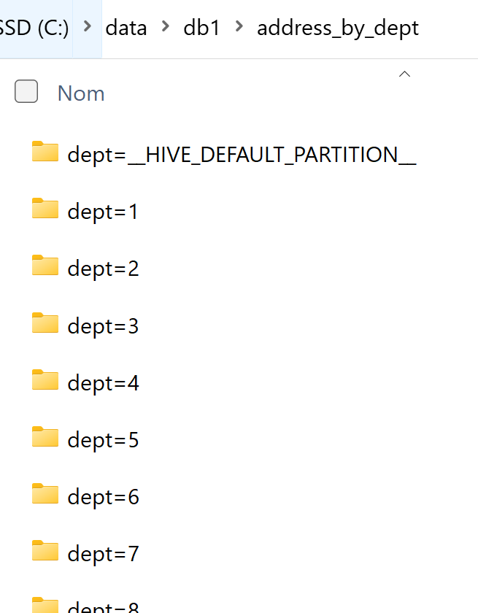
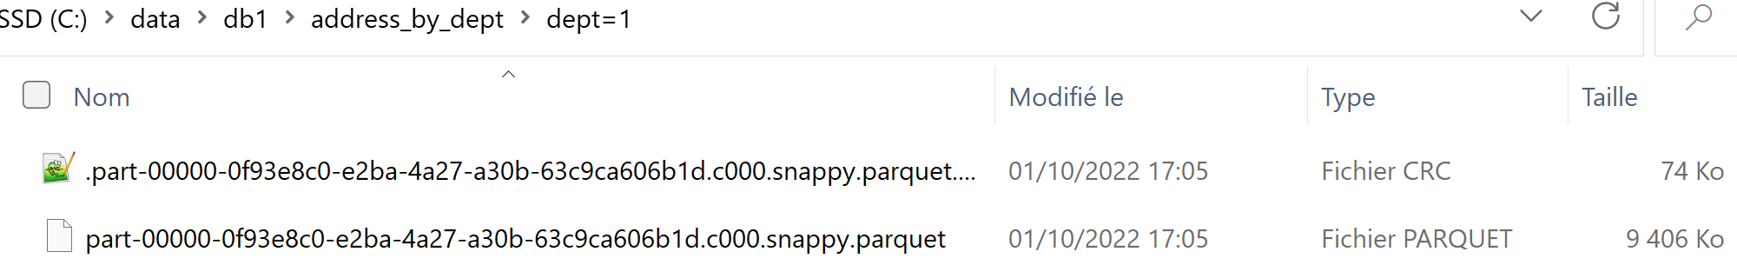
Reminder Exercise 1 : Directory /partCol=value/* data files do not contain « partCol »

Slide 9
Exercise 2: Execute « EXPLAIN <<SQL>> »
a/ Execute SQL… prefixed by “EXPLAIN” keyword
spark.sql("EXPLAIN select count(*) FROM db1.address_by_dept WHERE dept=92")
Hint: display nicely, using .show(false) OR .foreach(println(_))
b/ do you see “PartitionFilters: [ ..]” ?
c/ read Tree from depth-first : start from bottom (leaf) line, when understood then read line above (operator)

Slide 10
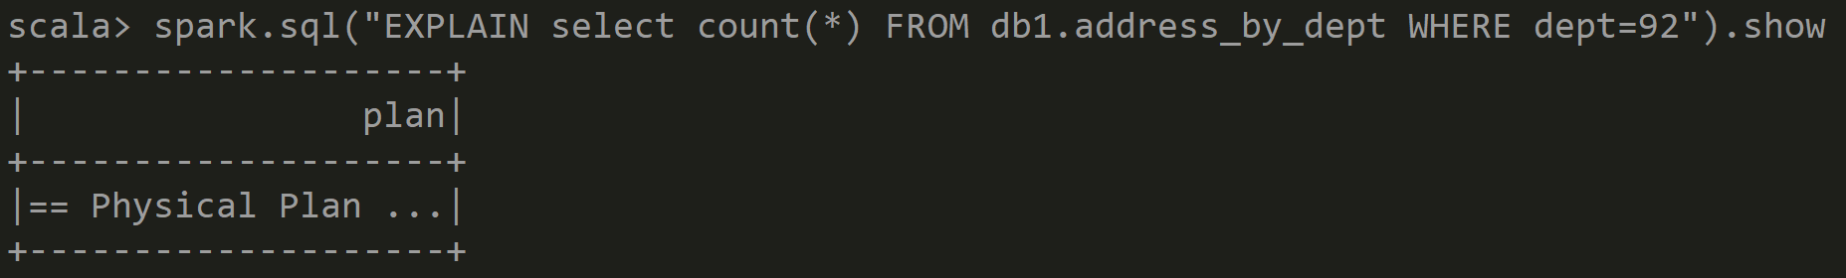
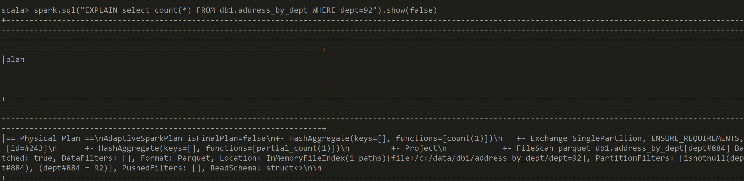
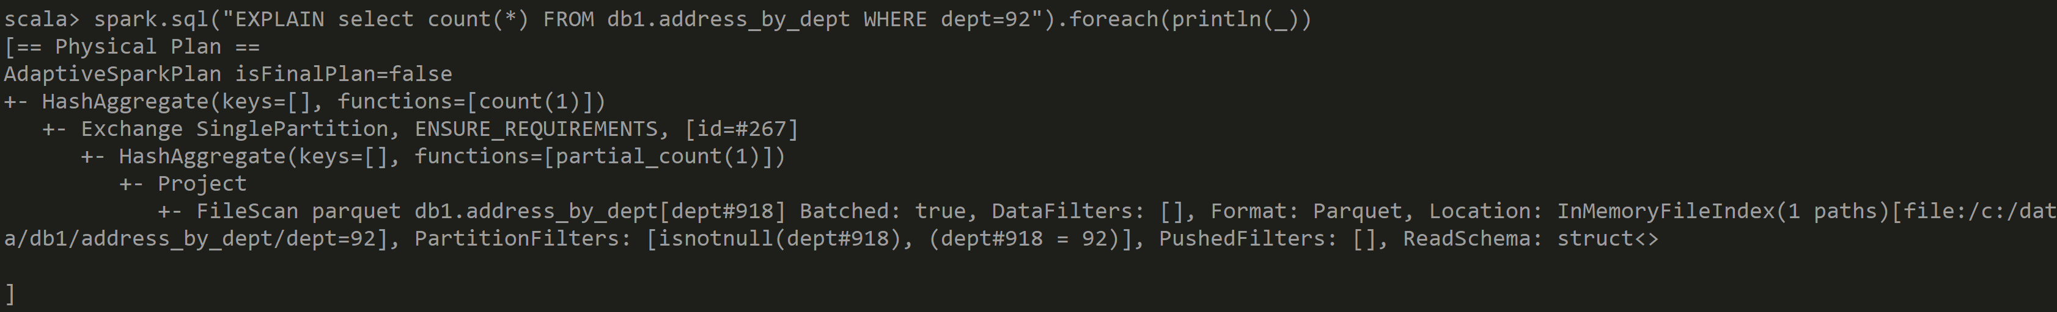
Answer Exercise 2: SQL Explain Plan

Slide 11
Exercise 3 : compare « EXPLAIN » queries
a/ Compare both
spark.sql("EXPLAIN select count(*) FROM db1.address_by_dept WHERE dept=92")
spark.sql("EXPLAIN select count(*) FROM db1.address WHERE dept=92")
b/ what changed ?

Slide 12
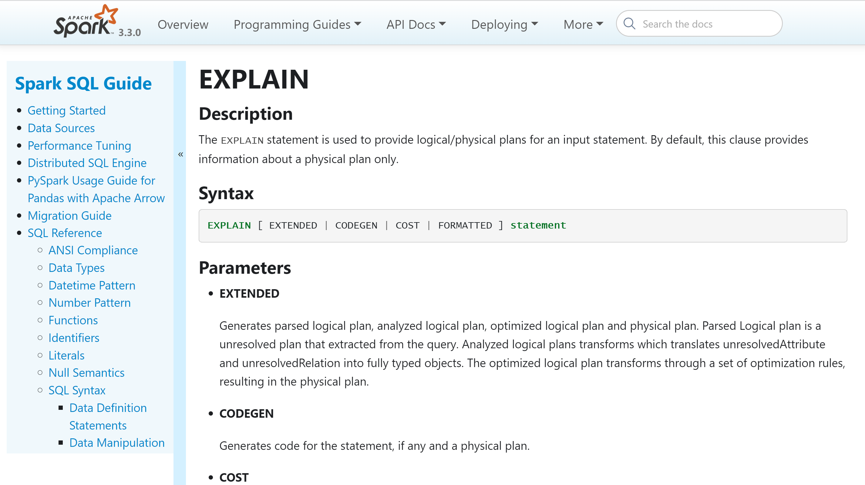
Optionnal Exercise 4: EXPLAIN [ EXTENDED | CODEGEN | COST | FORMATTED ]
https://spark.apache.org/docs/latest/sql-ref-syntax-qry-explain.html

Slide 13
Exercise 5: dataset.explain() API
val ds = spark.sql("select count(*) FROM db1.address_by_dept WHERE dept=92") ds.explain
ds.explain(false)
ds.explain(true)

Slide 14
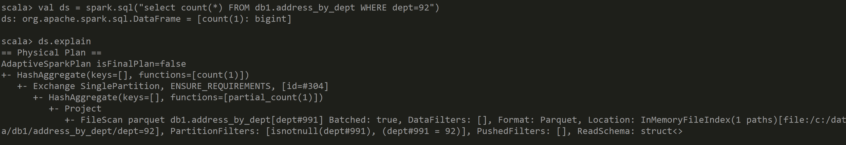
Answer Exercise 5: Dataset.explain

Slide 15
Objectives of Hands-On
1/ Execution Plan, SQL Explain / dataset.explain
2/ Spark UI, DAG, Narrow/Wide Transformations
3/ RDD cache / checkpoint
4/ Partition Pruning / Columns Pruning / Predicate-Push-Down
5/ Parquet Optims ( Sort, Stats, Dictionary, Bloom, BlockSize)
6/ JOINs, hint

Slide 16
Exercise 6 : Open Spark-UI browse to SQL -> last Query -> Detailed Plan
a/ Open Spark-UI at http://localhost:4040/
b/ go in last Tab « SQL / DataFrame »
c/ click on line for SQL Query
read the Execution Plan as Blue rectangles and Arrows(DAG)
d/ search carefully the PartitionFilters: [..] it appears twice: as mouse-over tooltip, and in Detailed text

Slide 17
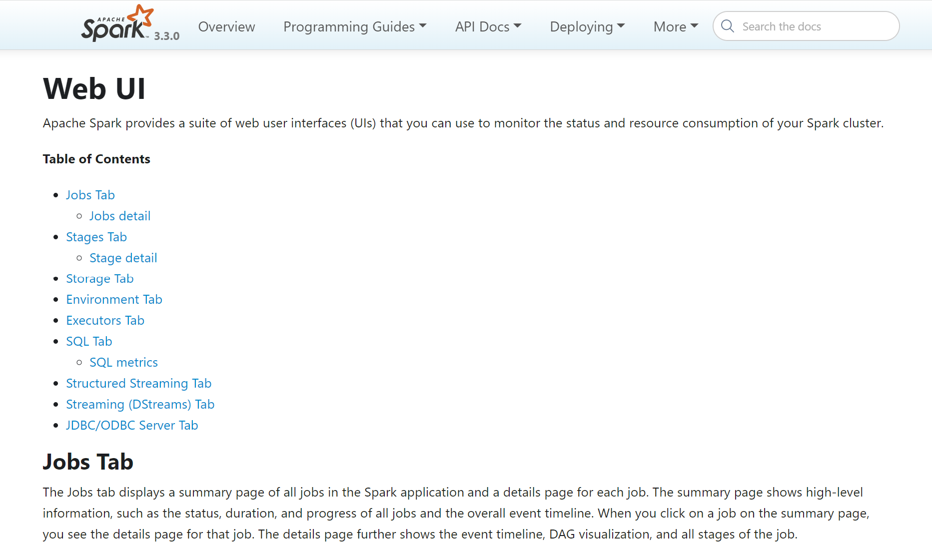
Exercise 6 : Spark UI Documentation…
https://spark.apache.org/docs/latest/web-ui.html

Slide 18
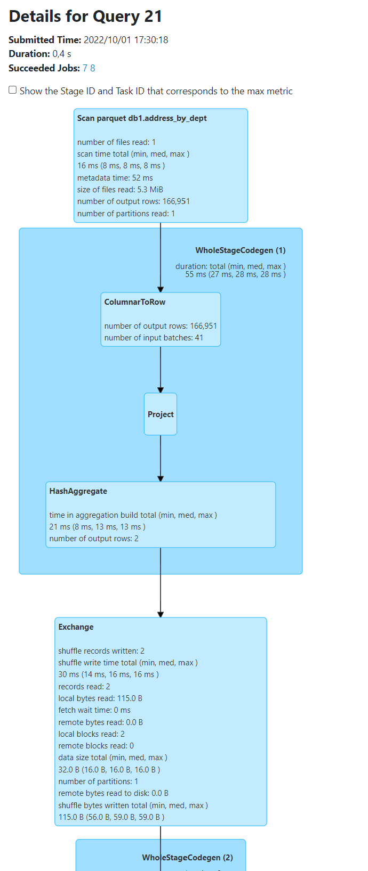
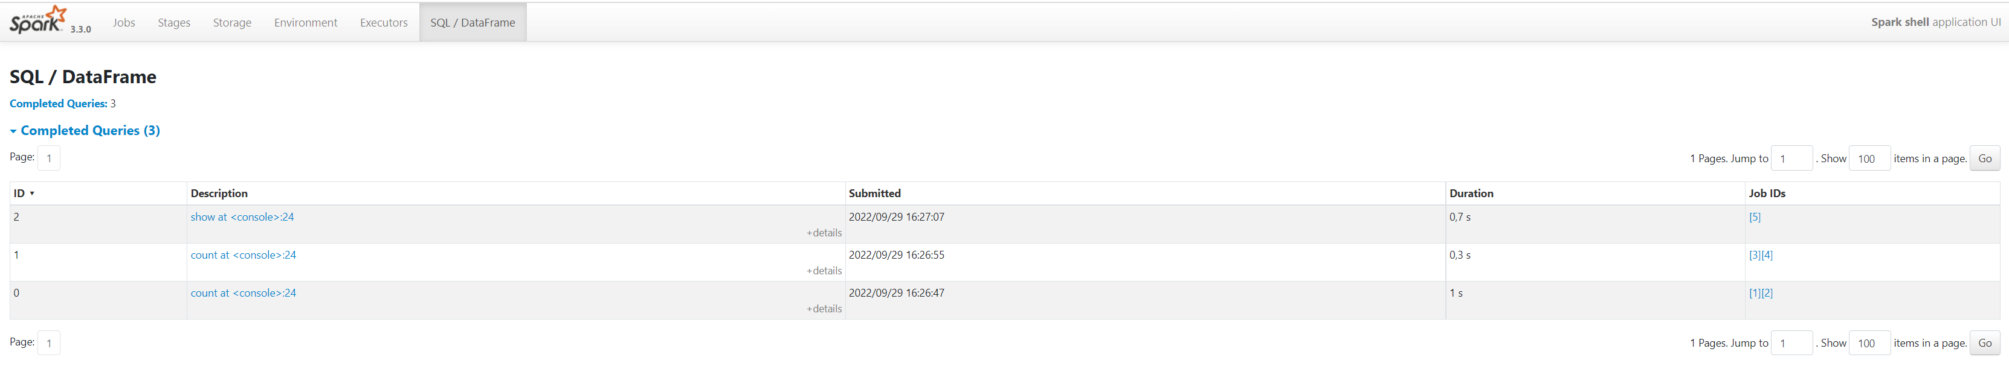
Answer Exercise 6

Slide 19
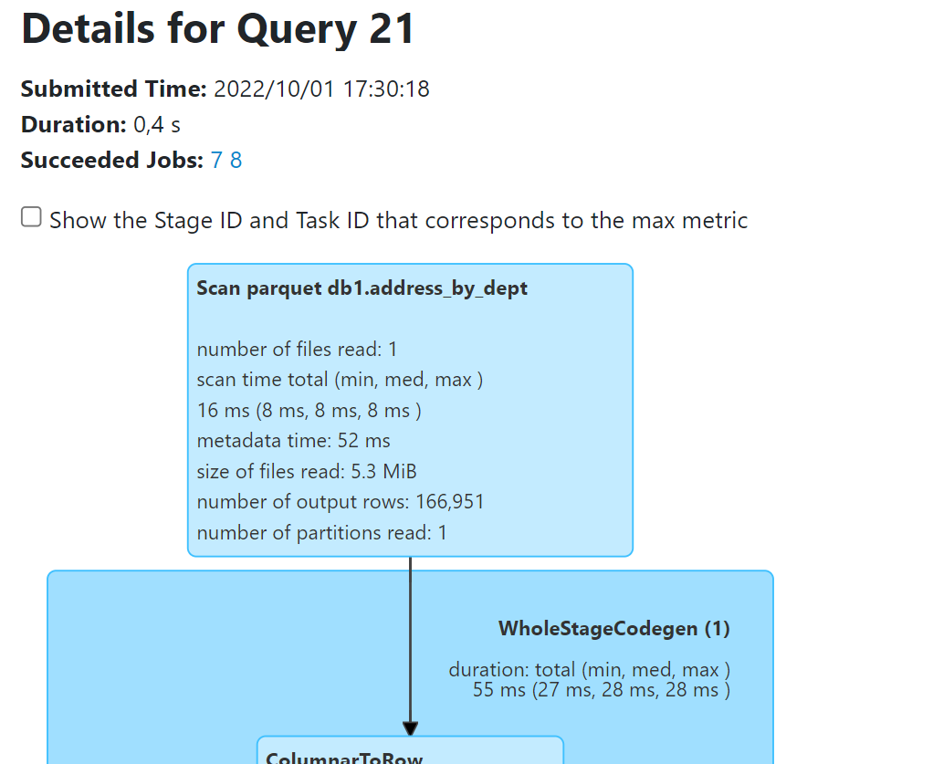
Partition Pruning … FirstClue: Only 1 File Read
Number of files read: 1 … was 1 file per partition
Number of partitions read: 1

Slide 20
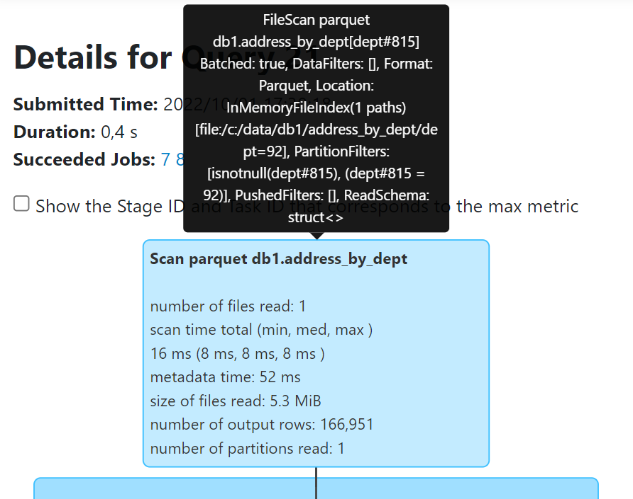
Exercise 6 … Search « PartitionFilters » in Explain Plan
PartitionFilters: [
isnotnull(dept#815),
dept#815 = 92
]
Move mouse over .. Show tooltip

Slide 21
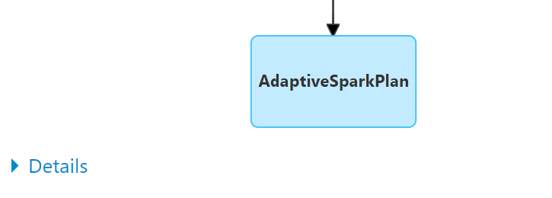
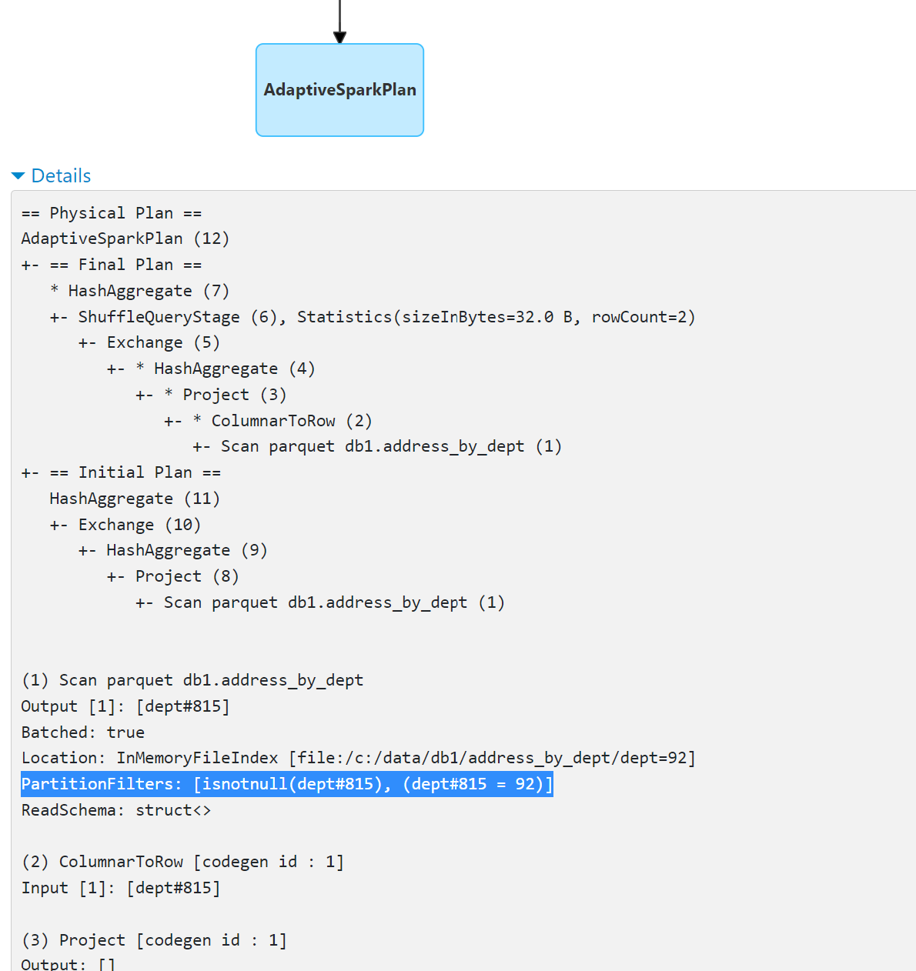
Exercise 6 … Search PartitionFilters:[..] in textual « Details »
Click Details
Expanded

Slide 22
Objectives of Hands-On
1/ Execution Plan, SQL Explain / dataset.explain
2/ Spark UI, DAG, Narrow/Wide Transformations
3/ RDD cache / checkpoint
4/ Partition Pruning / Columns Pruning / Predicate-Push-Down
5/ Parquet Optims ( Sort, Stats, Dictionary, Bloom, BlockSize)
6/ JOINs, hint

Slide 23
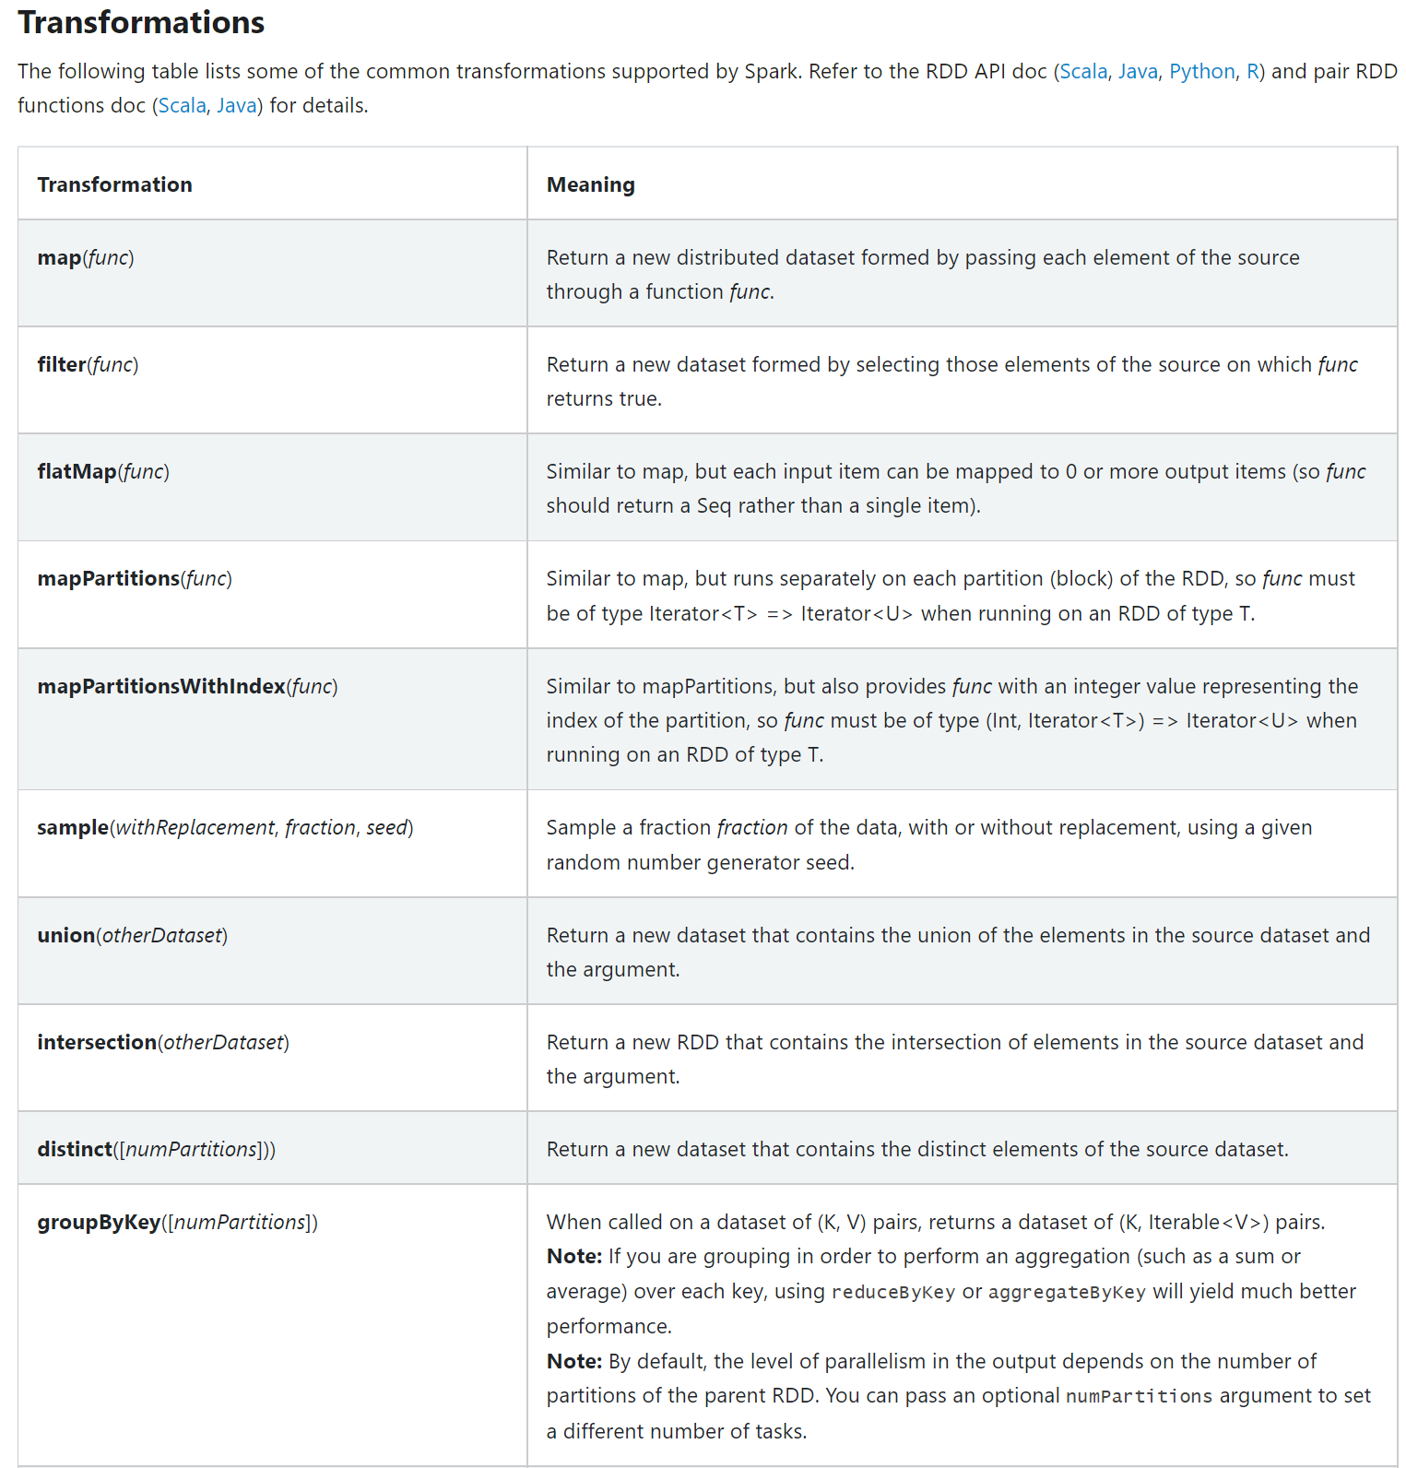
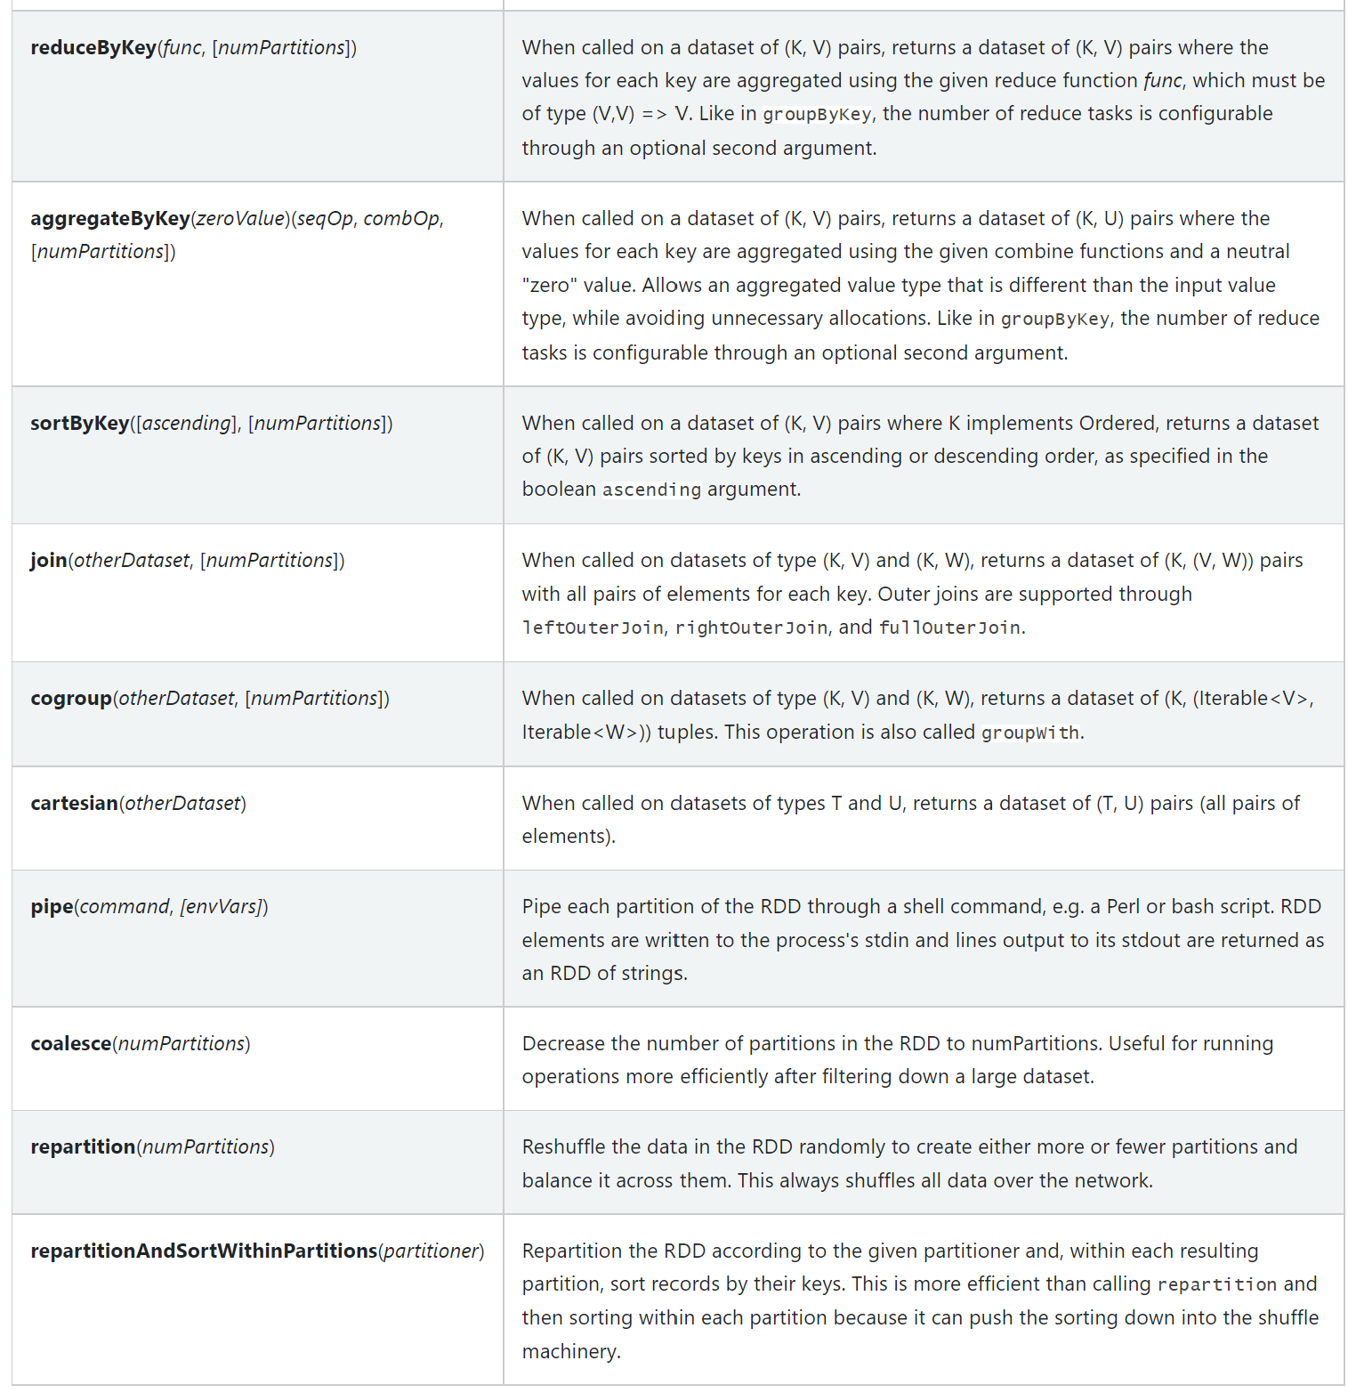
Reminder: Narrow/Wide Transformations
https://spark.apache.org/docs/latest/rdd-programming-guide.html#transformations

Slide 24
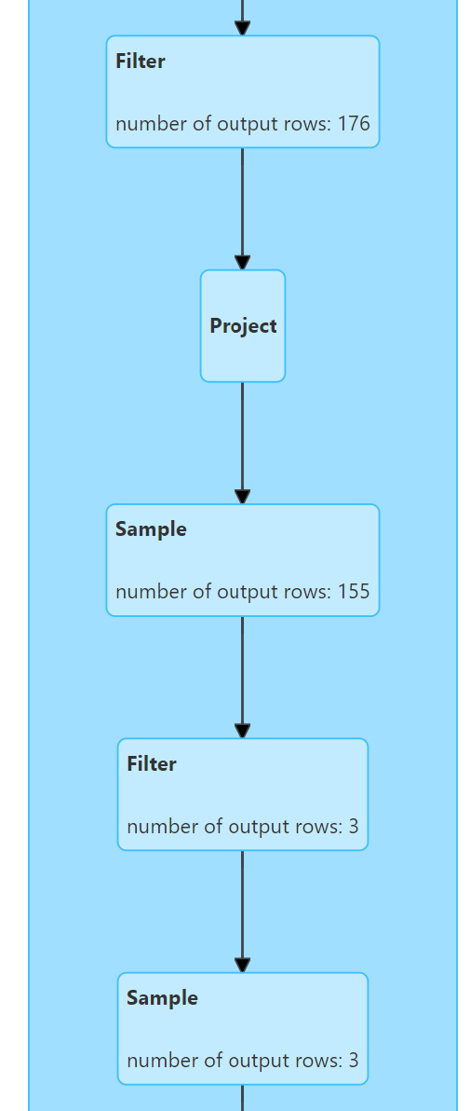
Exercise 7: combine several Narrow transformations filter, sample, select, withColumn …
a/ Execute query like
val addressDs = ….. .filter(a).filter(b) // => check Spark combine as .filter(a && b) !!
b/ ..like
addressDs .withColumn(..)
.filter( .. ) .sample(0.9)
.filter( .. ) .sample (0.9) .count
b/ Check in Spark UI that there is only 1 « WholeStageCodegen (1) » containing several instructions

Slide 25
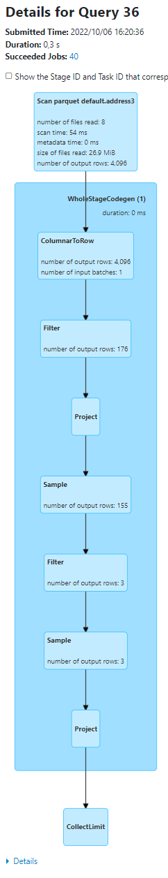
Answer Exercise 7:
Example spark.sql("select * from address3") .filter("commune_nom like '%n%’ »)
.withColumn("commune_nom2", col("commune_nom")) .filter("commune_nom2 like '%a%’ »)
.withColumn("commune_nom3", concat(col("commune_nom2"), lit("X")))
.sample(0.9)
.filter("commune_nom3 like '%t%’ »)
.sample(0.9)
.show(2, false)

Slide 26
Exercise 8: WholeStageCodegen java code for(;;) on Dataset<Row>…
a/ Show the corresponding generated Java Code of WholeStageCodegen
use ds.queryExecution.debug.codegen
b/ read it … find « .. extends org.apache.spark.sql.execution.BufferedRowIterator »
c/ find method @Override protected void processNext() { .. It is supposed to map copy all filtered rows x columns to new RDD[Row]
d/ do you find your filter conditions on your columns ?
https://github.com/apache/spark/blob/master/sql/core/src/main/java/org/apache/spark/sql/execution/BufferedRowIterator.java#L97

Slide 27
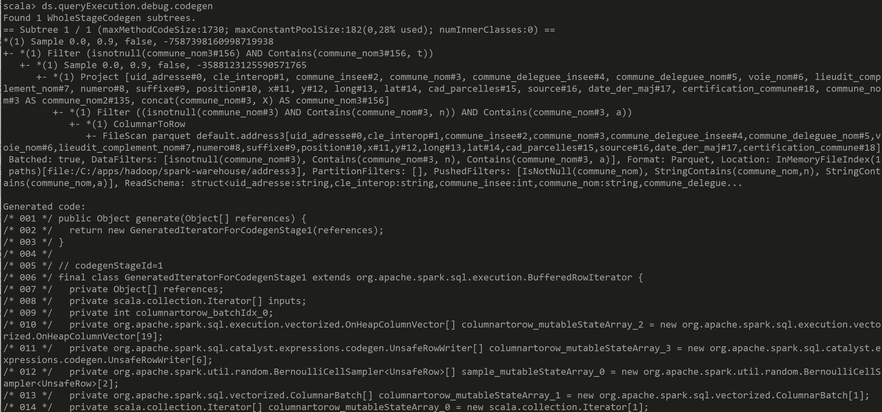
Answer Exercise 8

Slide 28
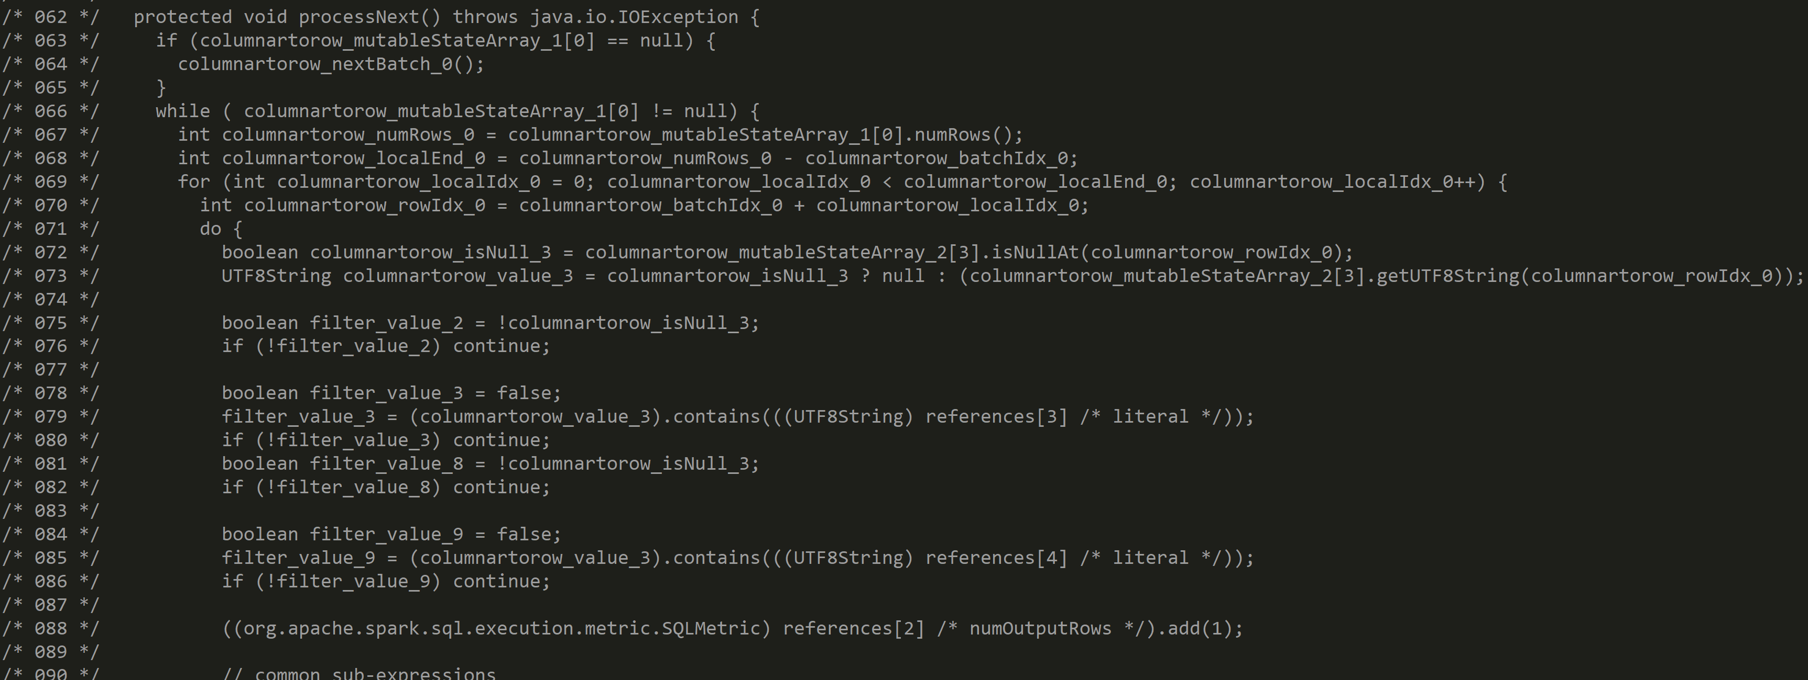
Answer Exercise 8

Slide 29
Exercise 9: cascade several Wide Transformations: repartition, groupByKey, aggregateByKey, aggregate, join, distinct
a/ Execute query like
addressDs .repartition(3)
.repartition(2, $"commune_insee")
.repartition(4)
.repartition(2, $"commune_nom")
.count
b/ Check in Spark UI that there are N shuffles

Slide 30
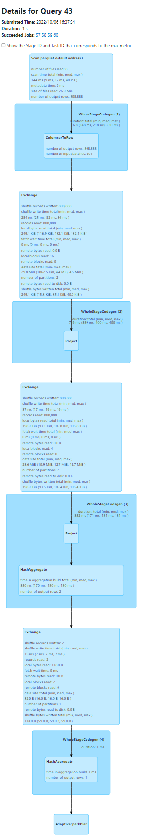
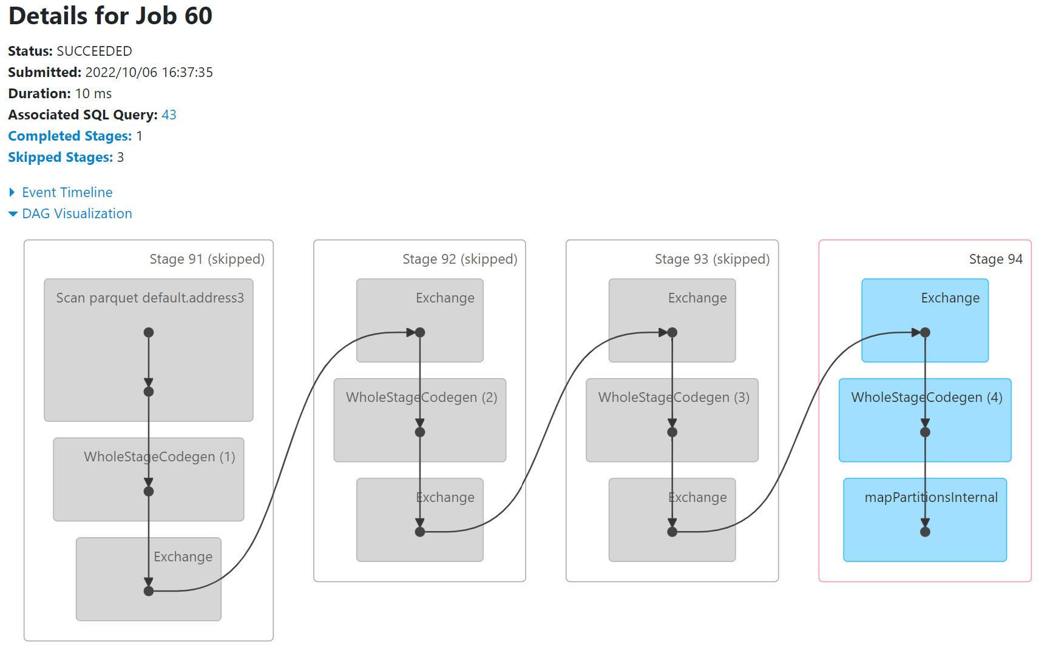
Answer Exercise 9:

Slide 31
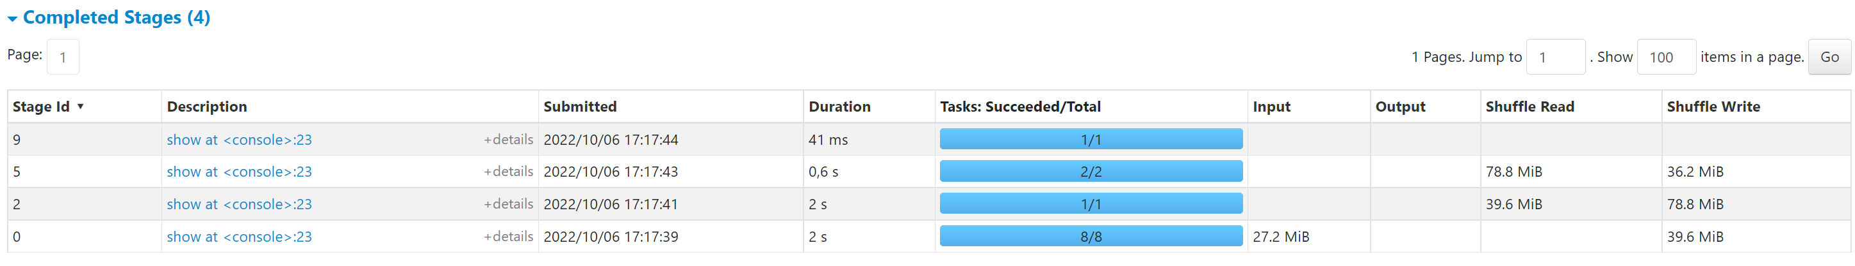
Exercise 10: Check on 2 consecutive Stages that previous Shuffle Write = next Shuffle Read

Slide 32
Exercise 11: Why do you see Greyed boxes… « Skipped Stages » ?
a/ If you don’t see… check you executed a wide transformation (not narrow)
b/ why all except the last Stage are greyed, and the last is blue?
c/ Spark automatically cache shuffling results ? (Spoil alert: Yes)
c/ But you can not see « green » point like in .cache() ? (Spoil alert: Yes) (cf next Exercise on dataset.cache() and .checkpoint() )

Slide 33
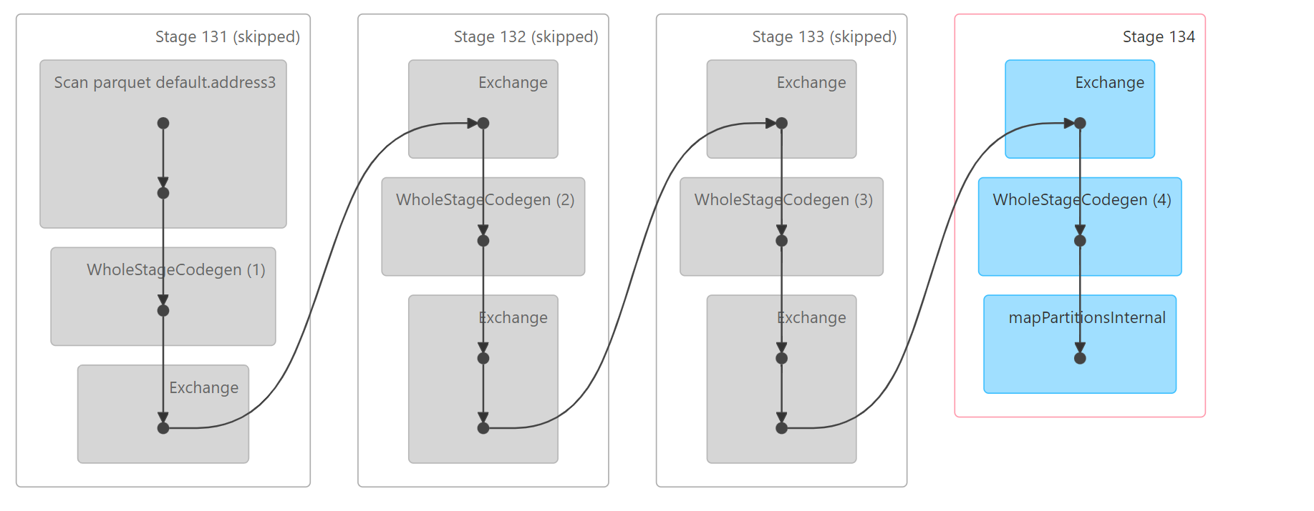
Answer Exercise 11: Skipped Stages
No shuffle result
For last Stage
… so NOT cached
Exchange Shuffle Result
..so automatically cached

Slide 34
Exercise 12: mix cascade of Narrow and Wide
Example
spark.sql("select * from address3")
.repartition(1).sample(0.9) .repartition(2).sample(0.8).filter("commune_nom like '%a%'")
.repartition(3).sample(0.7).filter("commune_nom like '%t%'").sample(0.6)
.count
a/ Explain how many Shuffles you expect
b/ How many instructions you expect in each WholeStageCodegen (1), WholeStageCodegen (2), WholeStageCodegen (3)

Slide 35
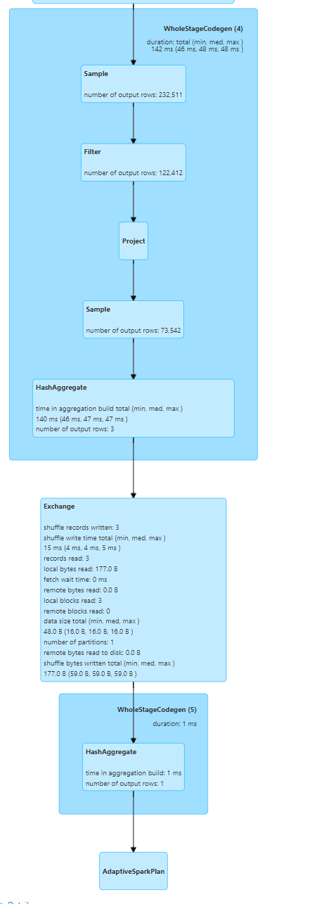
Answer Exercise 12
spark.sql("select * from address3")
.repartition(1) // wide
.sample(0.9) .repartition(2) // wide
.sample(0.8)
.filter("commune_nom like '%a%’ »)
.repartition(3) // wide
.sample(0.7)
.filter("commune_nom like '%t%’ »)
.sample(0.6)
.count

Slide 36
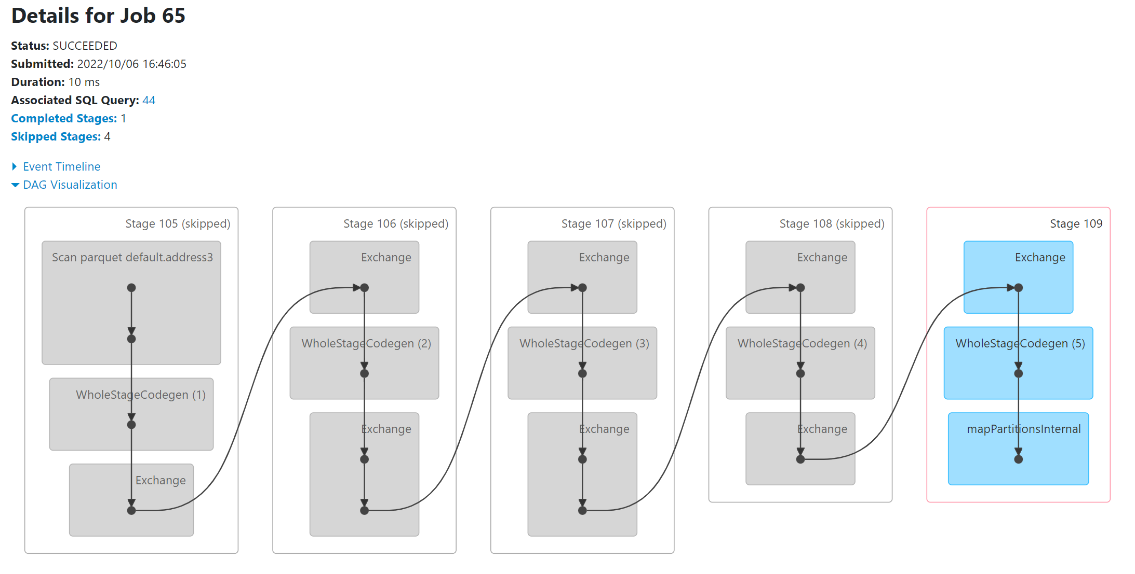
Answer Exercise 12

Slide 37
Objectives of Hands-On
1/ Execution Plan, SQL Explain / dataset.explain
2/ Spark UI, DAG, Narrow/Wide Transformations
3/ RDD cache / checkpoint
4/ Partition Pruning / Columns Pruning / Predicate-Push-Down
5/ Parquet Optims ( Sort, Stats, Dictionary, Bloom, BlockSize)
6/ JOINs, hint

Slide 38
Exercise 13: Several Actions on same Dataset
a/ Execute several actions on same Dataset ds.show
ds.show
b/ equivalently… several SQL
select * from address
select * from address
b/ Check in SparkUI that ds is recomputed each time !
c/ Check Spark File IO Statistics, Shuffle, Time elapsed

Slide 39
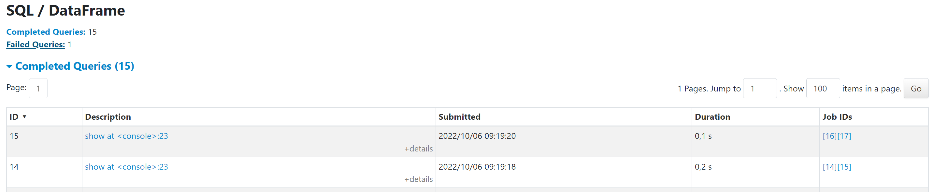
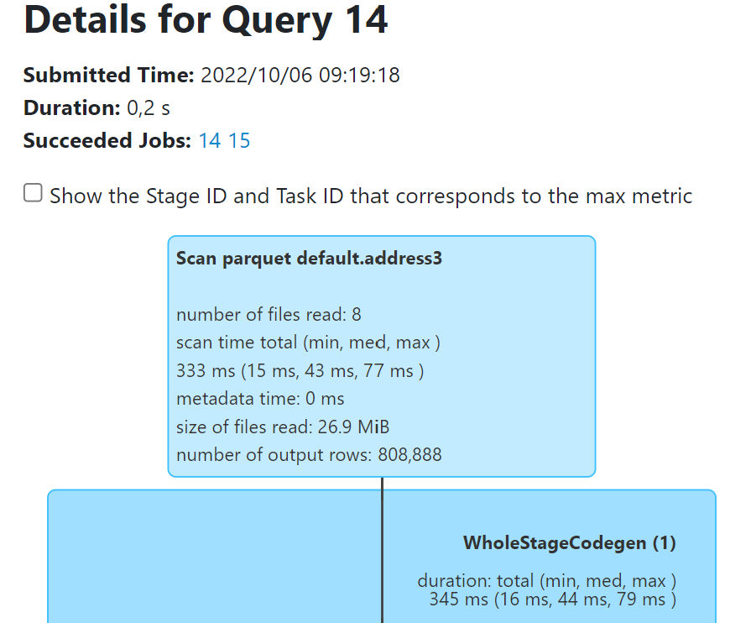
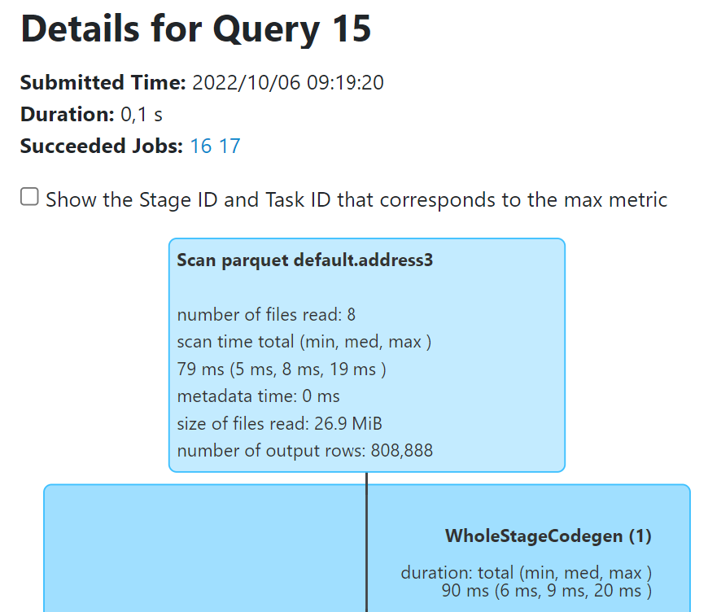
Answer Exercise 13:
Repeated
query
Similar
Files Read Count,
Bytes Read, Rows Count..
Different JobId, Times elapsedMillis

Slide 40
Exercise 14: Avoiding re-computation dataset .cache()
a/ Same as Exercise 12… but use before
ds.cache() // or equivalent: .persist()
Execute several actions on cached Dataset ds.show
ds.show
b/ Check in SparkUI that ds is NOT recomputed each time !
… But Full lineage is still displayed several time in greyed / with green point
c/ check in SparkUI > Storage > RDD
d/ and after … ds.unpersist()

Slide 41
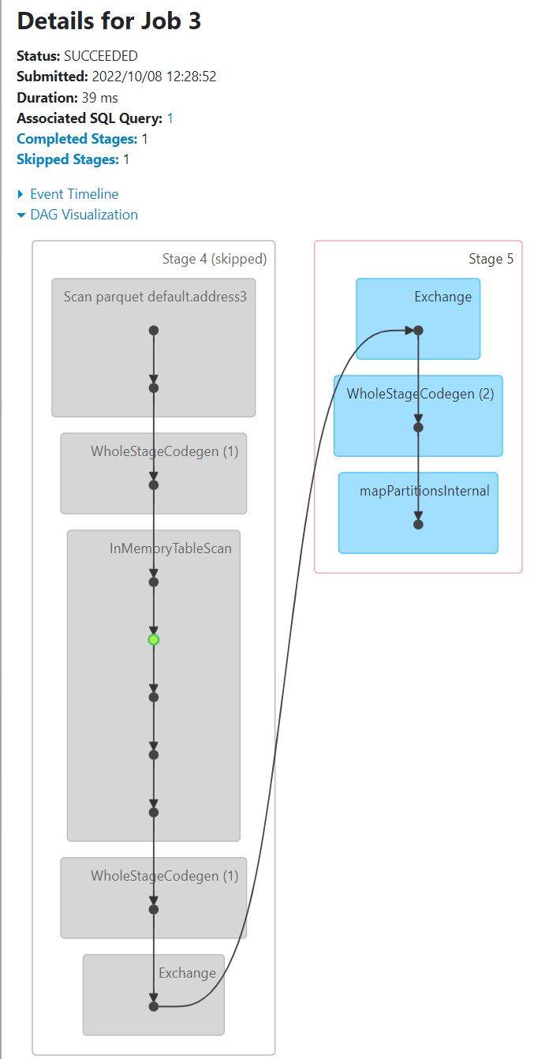
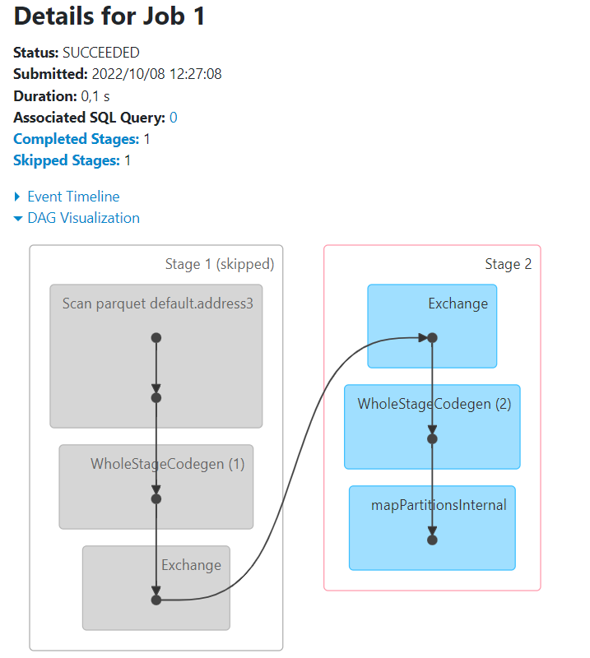
Answer Exercise 14: .cache() / .unpersist()
First Execute:
val ds = spark.sql("select * from address3") .filter("commune_nom like '%a%'")
ds.count
ds.cache
ds.count
ds.count
Ds.unpersist
ds.count
Same as 2.. Skipper Scan + filter
Same as 1.. Skipper Scan + filter
green point

Slide 42
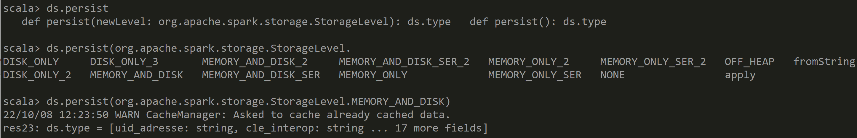
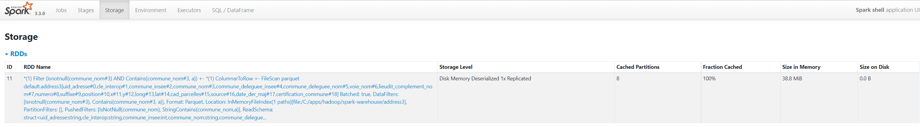
Answer Exercise 14

Slide 43
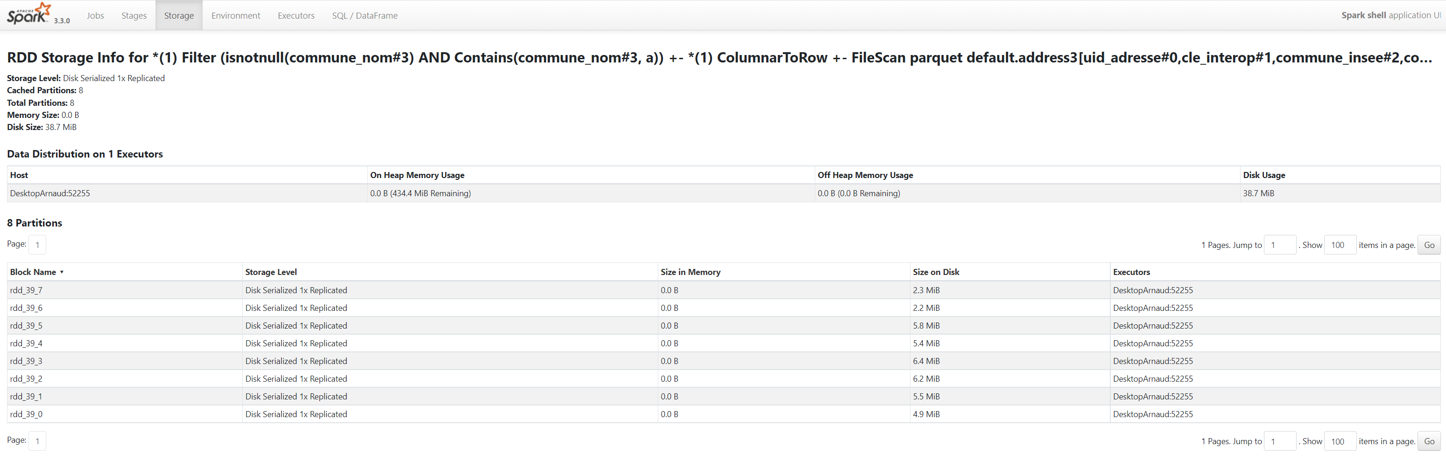
Anser Exercise 14: persist(DISK_ONLY)
Files Location … System.getProperty("java.io.tmpdir")
Example: C:\Users\arnaud\AppData\Local\Temp\blockmgr-a862d926-8354-44e4-b7c8-4676264742ea\37\rdd_39_5

Slide 44
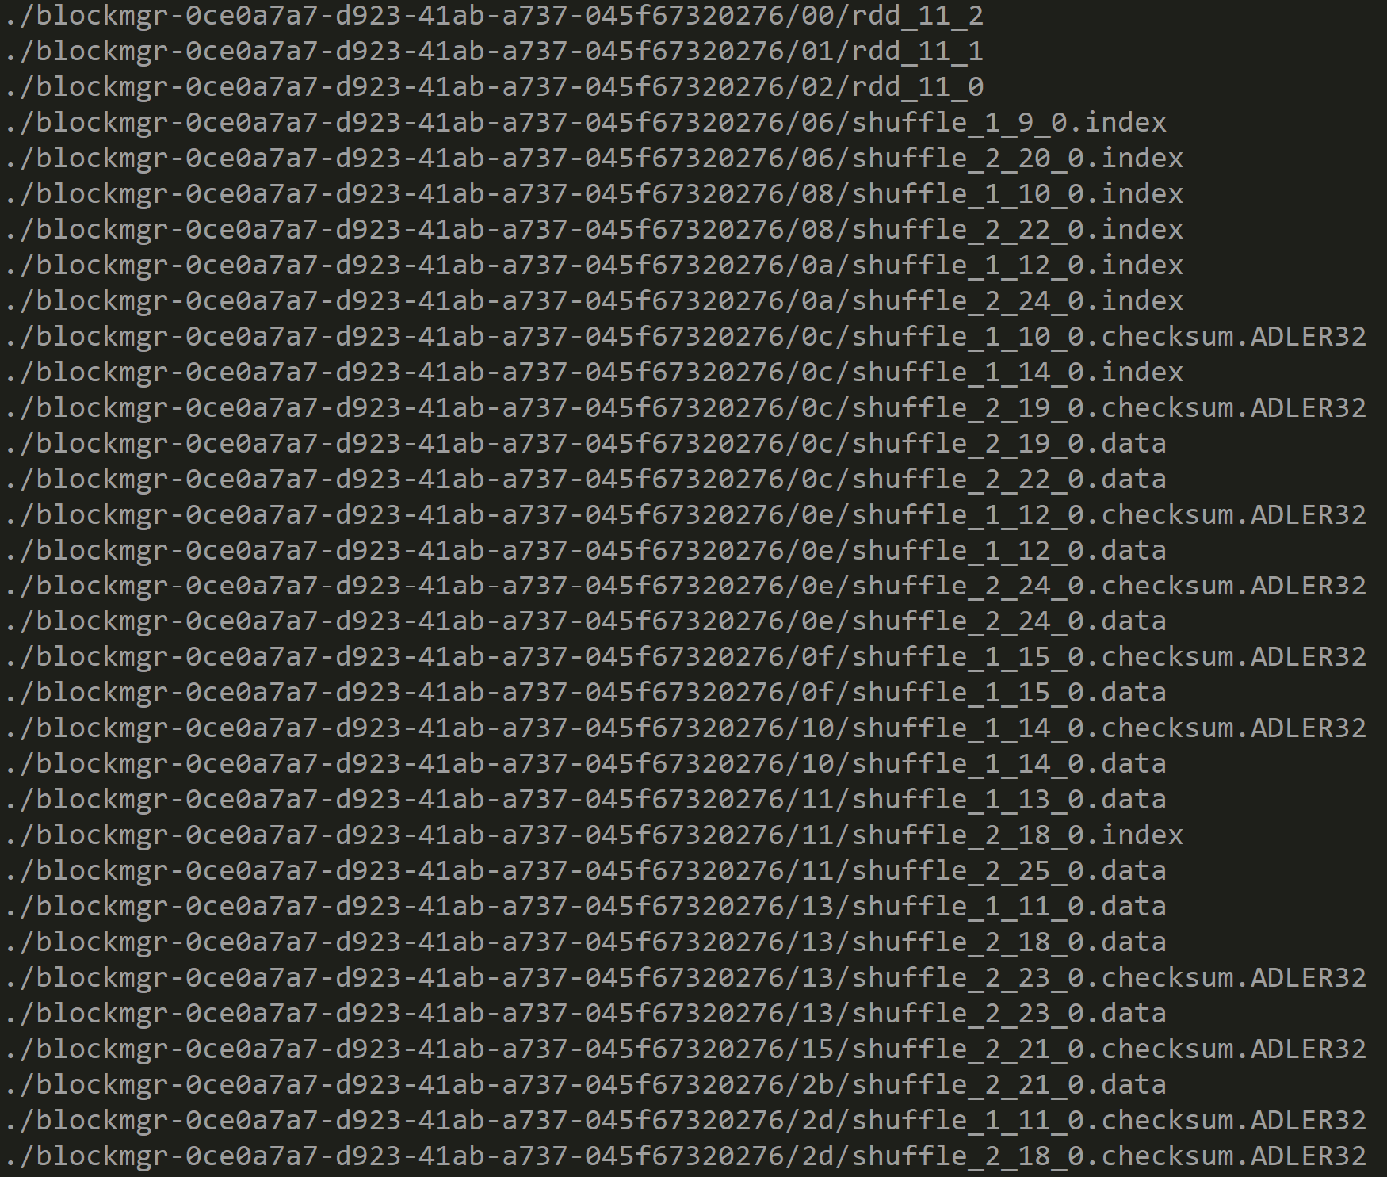
Answer Exercise 14: Files location for RDD and shuffles

Slide 45
Exercise 15: Execute complex DAG on dataset with lot of duplicates
Example: dataset repeated, with small variations, then union …
val ds1 = spark.sql("select * from address3").repartition(2).filter("commune_nom like '%n%'").repartition(2).sample(0.9);
val ds2 = ds1.union(ds1).limit(1000).repartition(2).sample(0.9);
val ds3 = ds2.union(ds2).limit(1000).repartition(2).sample(0.9).union(ds2);
val ds4 = ds3.union(ds3).limit(1000).repartition(2).sample(0.9).union(ds3);
val ds5 = ds4.union(ds4).limit(1000).repartition(2).sample(0.9).union(ds3);
ds5.count;
Open corresponding DAG in Spark UI

Slide 46
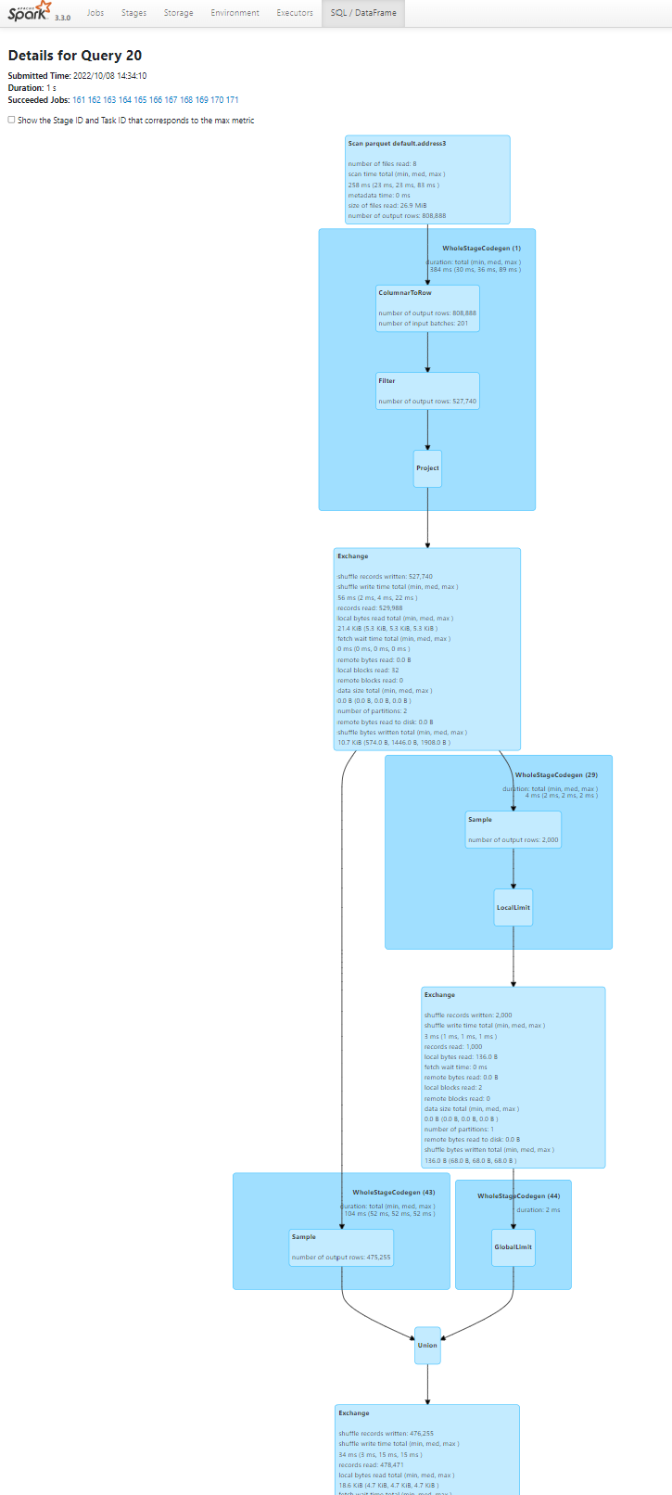
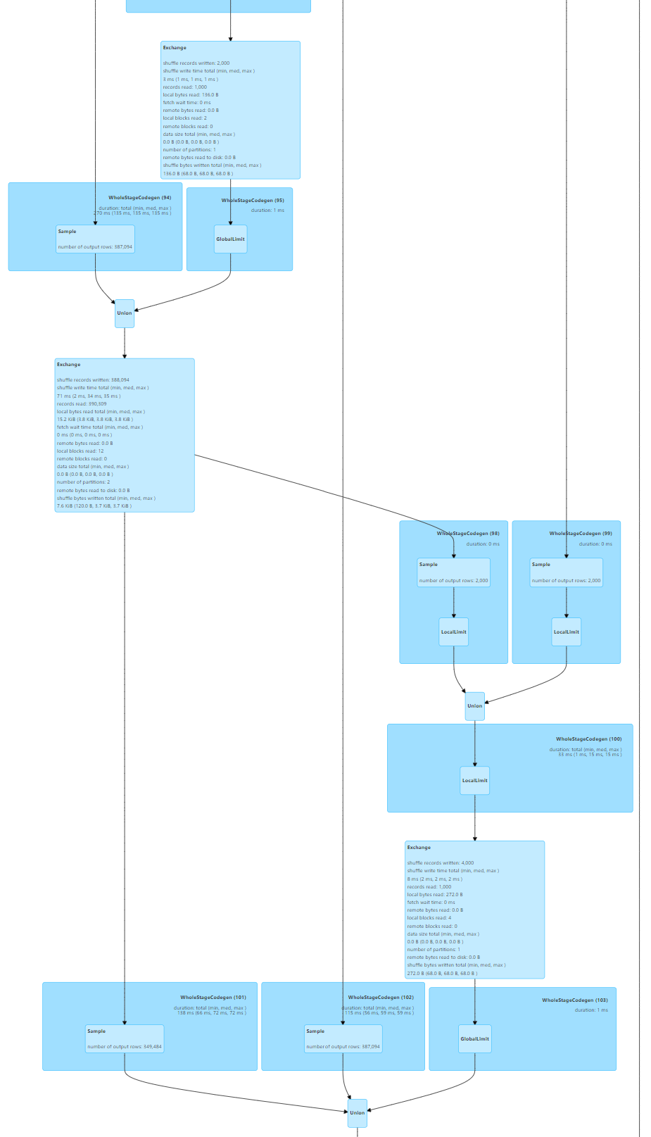
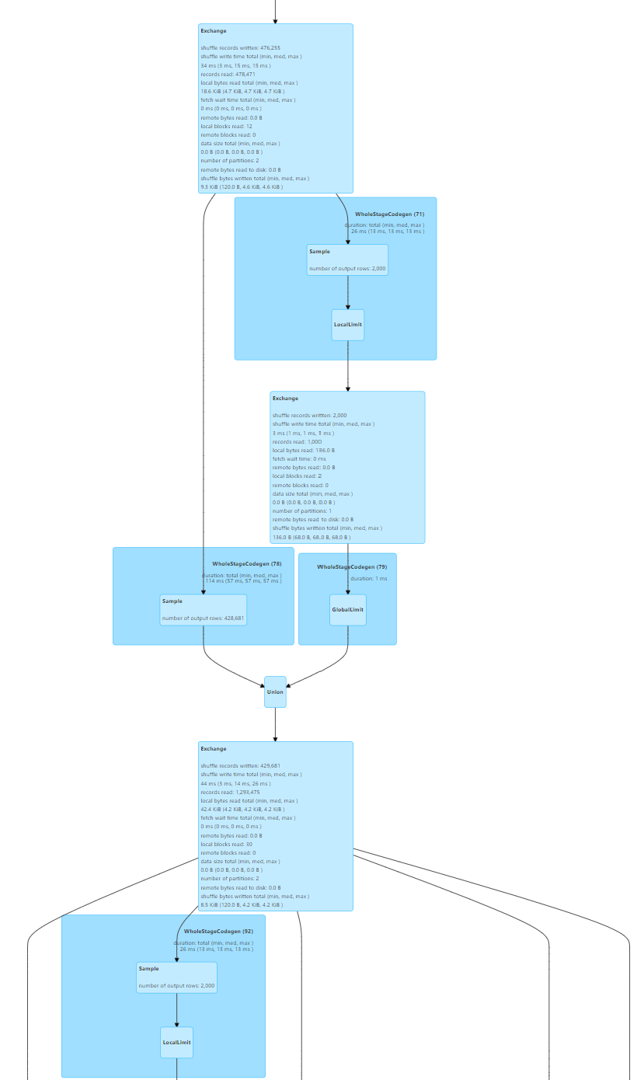
Answer Exercise 15: Read SparkUI DAG
And More..
(not shown)

Slide 47
Exercise 16: How to simplify DAG display ? … .checkpoint() !
a/ ensure
sc.setCheckpointDir(« c:/data/checkpoint-dir »)
b/ Same as Exercise 15… but use checkpoint:
ds3=.. val ds3 = ds3.checkpoint(); // IMPORTANT TO RE-ASSIGN
ds4=..
c/ Check in SparkUI that ds3 is persisted,
… AND lineage no more displayed
d/ there is NO « unCheckpoint() » as there is for unpersist()

Slide 48
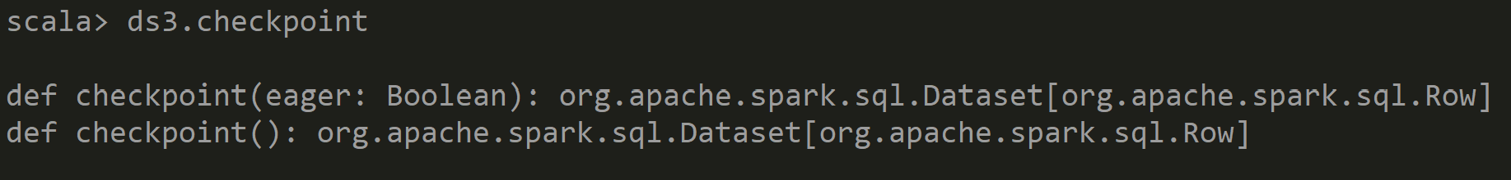
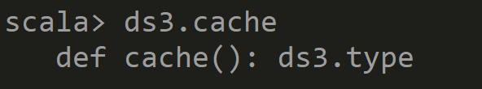
Exercise 16: .. Checkpoint directory has not been set in the SparkContext
sc.setCheckpointDir(« c:/data/checkpoint-dir »)
Signature: Dataset.checkpoint() ➔ return NEW Dataset !!
Different signature for .cache() !! No need to reassign

Slide 49
Exercise 16: checkpoint -> new Dataset
Signature: Dataset.checkpoint() ➔ return NEW Dataset !!
Different signature for .cache() !! No need to reassign
When checkpoint Files will be deleted ??
There is a flag … spark.cleaner.referenceTracking.cleanCheckpoint .. But Default to false
Checkpoint main usage is for Spark Streaming.. NOT DAG Optim

Slide 50
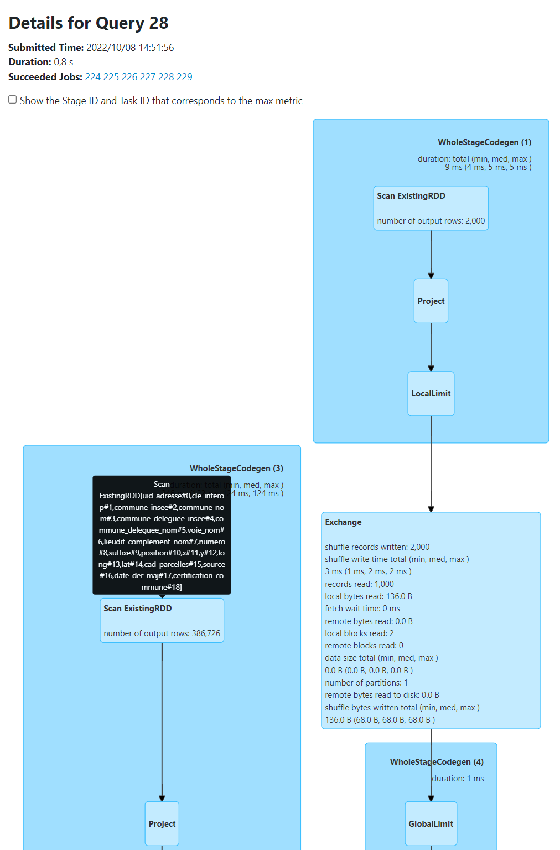
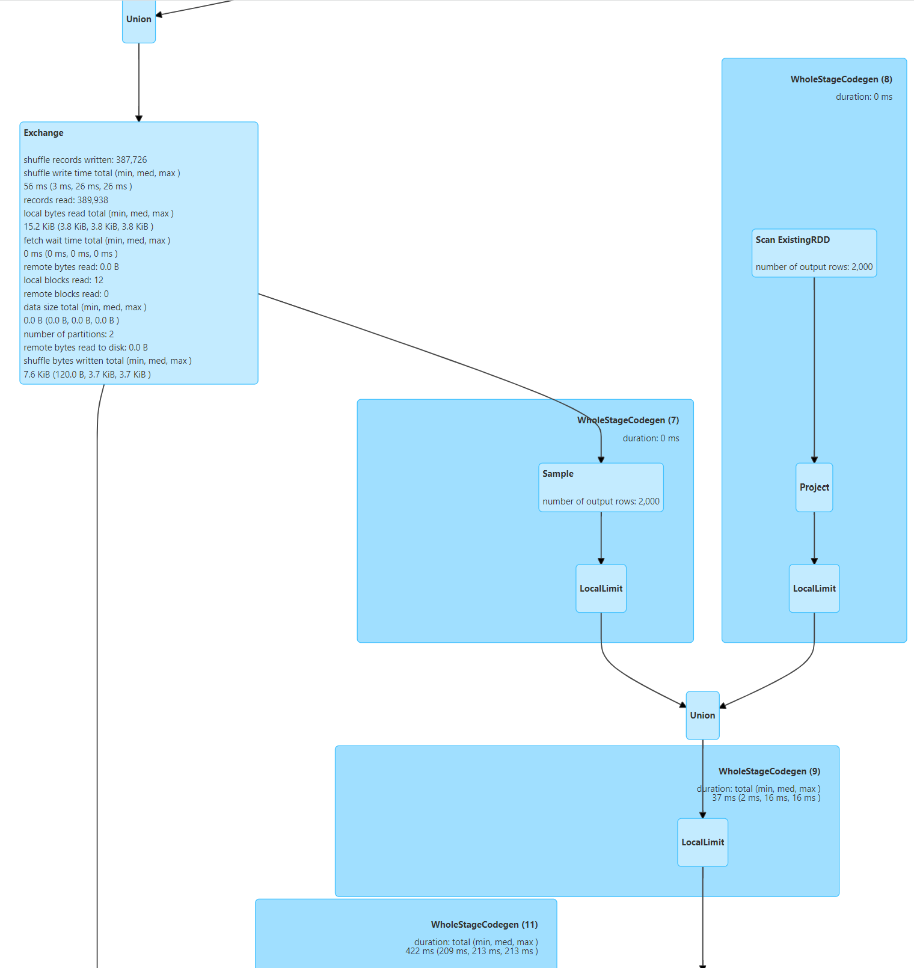
Answer Exercise 16: DAG with checkpoint
DS3..
DS3… inlined as
« Scan Existing RDD »
And More..
(not shown)

Slide 51
10 mn pause

Slide 52
Objectives of Hands-On
1/ Execution Plan, SQL Explain / dataset.explain
2/ Spark UI, DAG, Narrow/Wide Transformations
3/ RDD cache / checkpoint
4/ Partition Pruning / Columns Pruning / Predicate-Push-Down
5/ Parquet Optims ( Sort, Stats, Dictionary, Bloom, BlockSize)
6/ JOINs, hint

Slide 53
Exercise 17: Reminder Partition Pruning
There are 3 « Pruning » Optimizations done by Spark
1/ Column Pruning
2/ Partition Pruning
3/ Predicate-Push-Down (Block pruning)
Question:
a/ do you remember what is « Partition Pruning » ?
b/ was it always a good optimization to have many (small) partitions ?

Slide 54
Exercise 18: Column Pruning
Reminding that Parquet is a « Columnar File Format »
Check by reading only 1 column, that Spark does not read fully Parquet Files
… only Page block of selected column.
This is « Column Pruning »
Example: spark.sql(« select distinct commune_nom from address »).count
Check in SparkUI the File Bytes read statistics.
Compare with total file size

Slide 55
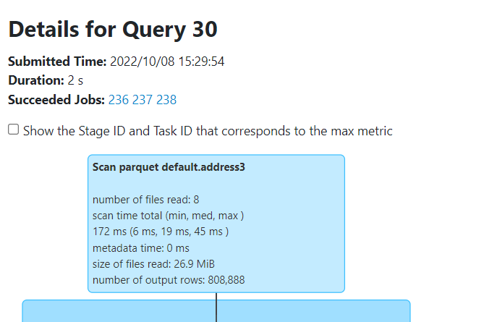
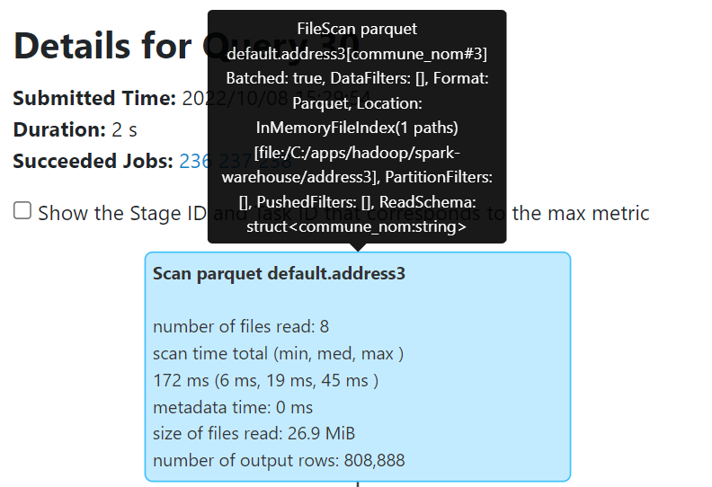
Answer Exercise 18: Column Pruning
Reading only column
« commune_nom#3 »
Total Size of files: 26.9 MiB
( will not be read fully)
Input : 667.6 KiB

Slide 56
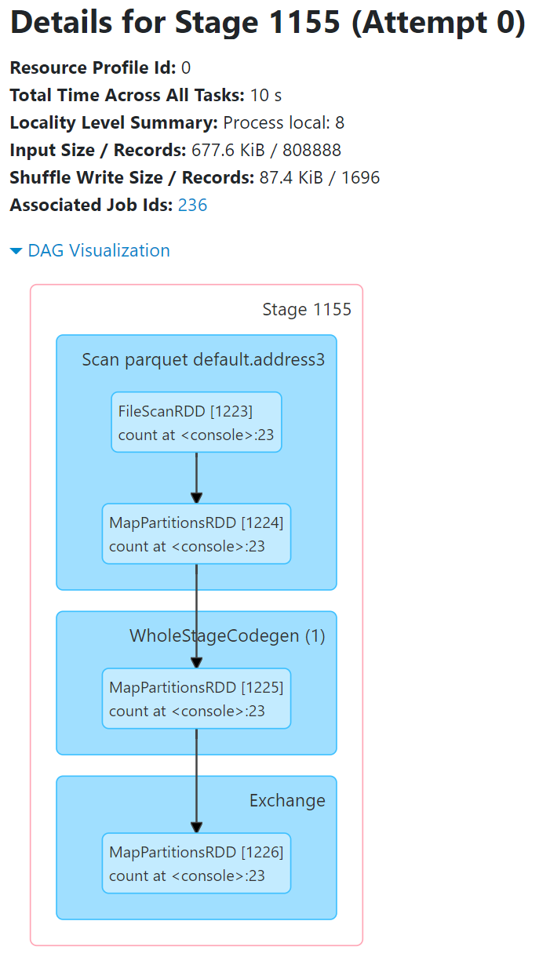
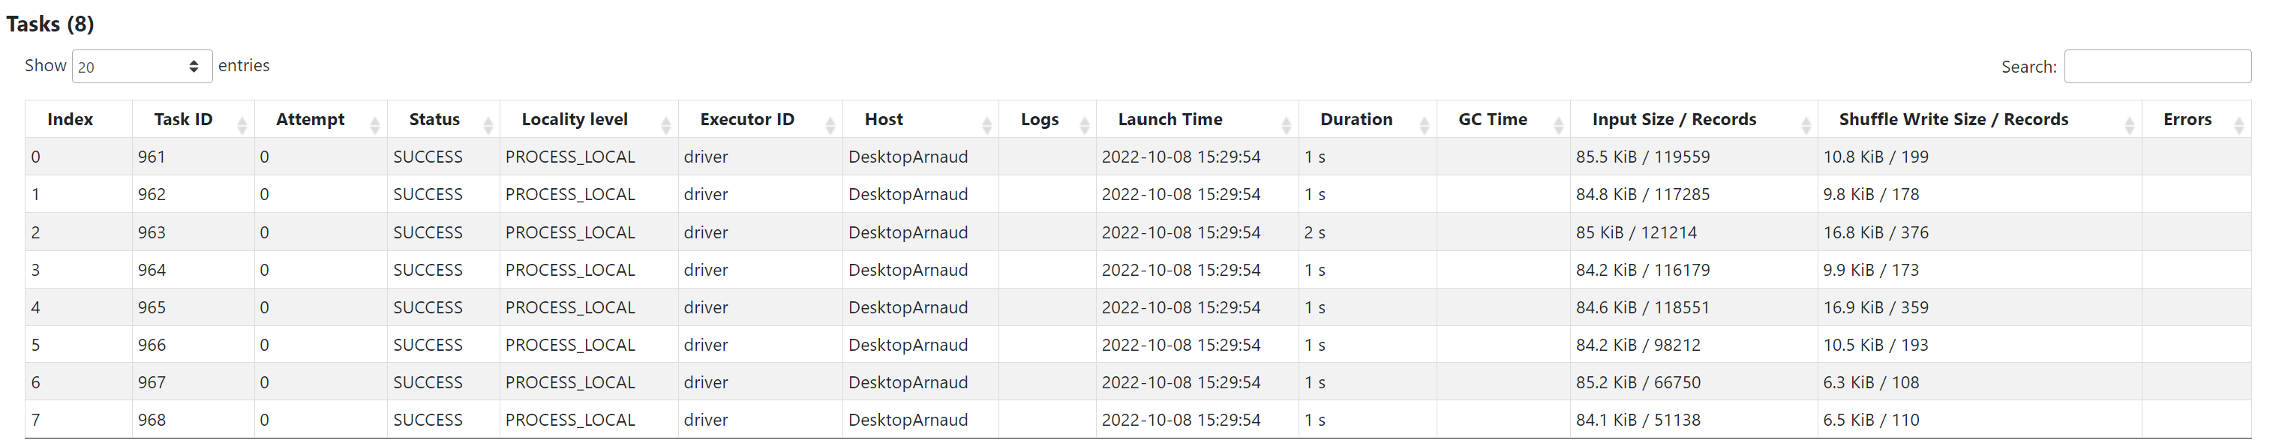
Answer Exercise 18: Column Pruning
Read 677.6 KiB
Details of Input Size / Records per Task

Slide 57
Exercise 19: Predicate-Push-Down
a/ Execute following Queries
select count(*) from db1.address where commune_nom = ‘Nanterre’
select count(*) from db1.address where UPPER(commune_nom) = ‘NANTERRE’
select count(*) from db1.address where commune_nom lke ‘%Nanterre%’
b/ Check in SparkUI the execution Plan
Search for « PushedFilters:[ .. ] »
c/ For which query Spark is able to push down « all conditions » to parquet library ?
d/ Is is always « much better » to have predicate beeing pushed down ? What is missing to be better ?
Hint: use sc.setCallSite(« query comment») to find easily your query in Spark UI

Slide 58
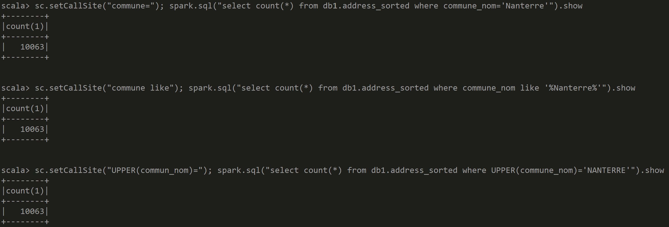
Answer Exercise 19: Predicate-Push-Down
This query OBVIOUSLY slower… see progress bar in console: ==========> [23/48]

Slide 59
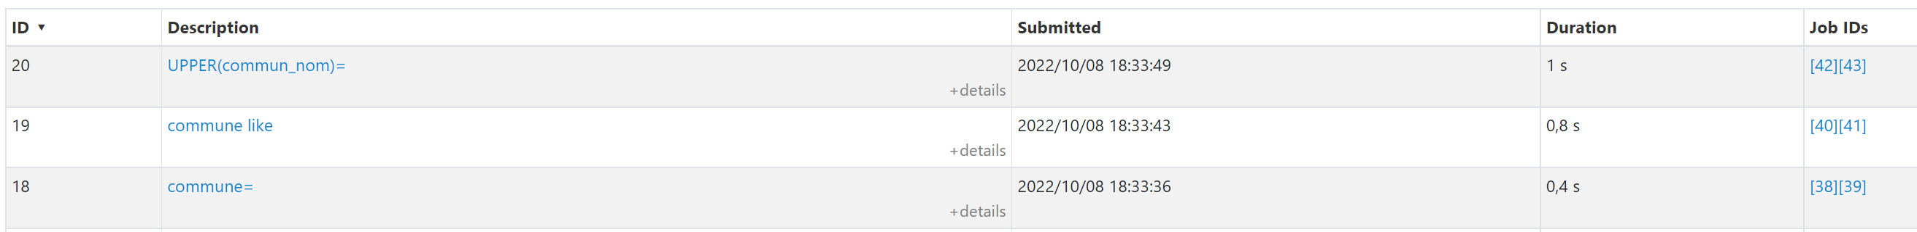
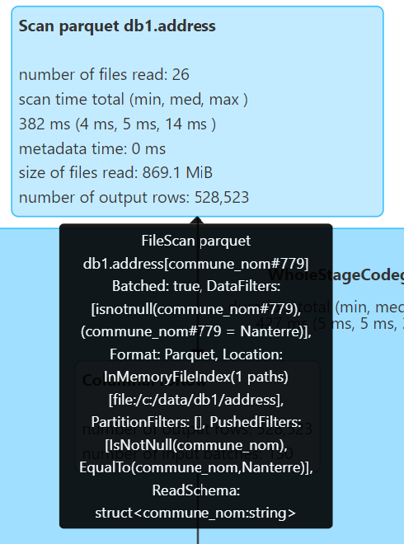
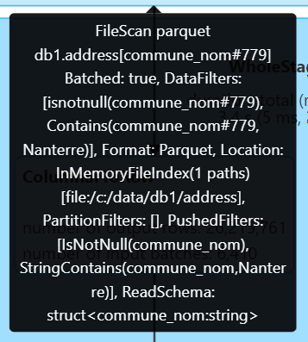



Answer Exercise 19:
WHERE commune=
WHERE commune like ‘%Nanterre%’
WHERE UPPER(commune)=
Condition NOT pushed-down
ONLY « IsNotNull» !!
…by chance, regexp can be converted to commune contains ‘Nanterre’
FULL Pushed BUT less efficient: StringContains
FULL Pushed EqualTo
In Details… Pushed « EqualTo »

Slide 60
Objectives of Hands-On
1/ Execution Plan, SQL Explain / dataset.explain
2/ Spark UI, DAG, Narrow/Wide Transformations
3/ RDD cache / checkpoint
4/ Partition Pruning / Columns Pruning / Predicate-Push-Down
5/ Parquet Optims ( Sort, Stats, Dictionary, Bloom, BlockSize)
6/ JOINs, hint

Slide 61
Exercise 20: prepare sorted parquet table for Predicate-Push-Down
We want to have few PARQUET files (1 or several, but not hundred)
Each PARQUET File split in several blocks of 16Mo (default=256Mo)
Each block sorted to have efficient Dictionaries and Min-Max Statistics
val allAdressCsvDs = spark.read.options(Map("header" -> "true", "delimiter" -> ";", "inferSchema" -> "true")).format("csv").load("C:/data/OpenData-gouv.fr/bal/adresses-france.csv")
.withColumn("dept", regexp_replace(col("commune_insee"), "0*(.*)...", "$1").cast("int"))
.withColumn("code", col("commune_insee").cast("int"))
allAdressCsvDs.repartition(1)
.sort("dept").sortWithinPartitions("dept", "code", "voie_nom")
.write.format("parquet").option("parquet.block.size", 16*1024*1024)
.saveAsTable("db1.address_sorted")
allAdressCsvDs.repartition(10, col("dept")) .sortWithinPartitions("dept", "code", "voie_nom")
.write.format("parquet").option("parquet.block.size", 16*1024*1024)
.saveAsTable("db1.address_sorted10")

Slide 62
Exercise 20 … write.option() or global --conf ??
Use
spark-shell --driver-memory=3g \ --conf spark.sql.files.maxPartitionBytes=16777216 \ --conf parquet.block.size=16777216

Slide 63
Exercise 21: check.. getNumPartitions
Check that
a/ table db1.address_sorted is saved on 1 parquet file, and file is split into 55 partitions giving a total of numPartition=55
b/ table db1.address_sorted10 is saved on 10 parquet files and files are split (differently..) giving a total of numPartition=57
c/ is there a big difference between a/ and b/ ? Which is « better » ?
Hint: use dataset.toJavaRDD.getNumPartitions

Slide 64


Answer Exercise 21
1 File 886 Mo
55 partitions
10 Files
between 40Mo - 130Mo ( total ~886 Mo)
57 partitions
(only 7 files are split in 2 all other have 1 part)

Slide 65
Answer Exercise 21: difference between 1 File-N Partitions <<>> N files- each 1 partition
In both case there is approximatly 55 partitions
But case a/ is MUCH BETTER
Because there is less files
No overhead to duplicate read File metadata (same schema+different offsets)
No overhead for the storage filesystem to store N files

Slide 66
Exercise 22: Predicate-Push-Down
Execute several Queries with WHERE clauses « field=value »
and see efficiency of Skipped/Read bytes compared to total file size
select count(*) from db1.address_sorted where …
a/ where commune_nom=‘Nanterre’
b/ where code=92050
c/ where commune_nom=‘La Clusaz’
d/ where code=74080
Check that results count a=b and c=d
Compare Bytes read for each query … Are they same a=b? c=d? a=c? b=d?
Search in Plan « PushedFilters: [ ..] »
Hint: use « sc.setCallSite(« DisplayName »); » to find queries more easily in Spark UI

Slide 67

Answer Exercise 22:
So a != b, b != d
And it seems that a=c, b=d
For a|c => Spark need to read « code » statistics (minValue,maxValue), then Spark read all blocks matching
For b|d => Spark need to read « commune_nom » Bloom filter then Dictionaries, then Spark read all blocks matching

Slide 68

Answer Exercise 22:
Read Input Size per Tasks … There are 55 parallel tasks (but 1 File)

Slide 69

Optional Exercise 23: redo select on non-existing value
Execute
select count(*) from db1.address_sorted where …
a/ where commune_nom=‘UneVilleQuiNExistePas’
b/ where code=9999999
Question:
What is still read by Spark ?

Slide 70
Answer Exercise 23:
15.0 < 15.2 MiB for existing one
18.6 < 18.9 MiB for existing one
In exercise 20, Spark could select data from matching page blocks
(obviously, using « select * » isntead of « select count(*) » requires more data )
Here, we are sure Spark only read Statistics / Bloom Filter / DictionaryPages

Slide 71
Objectives of Hands-On
1/ Execution Plan, SQL Explain / dataset.explain
2/ Spark UI, DAG, Narrow/Wide Transformations
3/ RDD cache / checkpoint
4/ Partition Pruning / Columns Pruning / Predicate-Push-Down
5/ Parquet Optims ( Sort, Stats, Dictionary, Bloom, BlockSize)
6/ JOINs, hint

Slide 72
Exercise 24: Join
a/ Extract and save from table address a new table « city »
Containing « name, code, dept, average_address_longitute, average_address_lattitude »
b/ Join table « address » and « city »,
and compute for each address the offset longitude/latitude to the city average center
c/ study Execution plan
can you force « Broadcasting » the small city table ?

Slide 73
Answer Exercise 24:

Slide 74
Optional Exercise 25: Default Shuffle = 200 ?!
Study number of partitions after a join
a/ is it 200 ? Why
b/ How do you change default ?
c/ What should you always do before saving to File(s)? (to avoid 200)

Slide 75
Answer Exercise 25:

Slide 76
Exercise 26 : MindMap
Draw a MindMap to summarize
what you did and learn from this Hands-On session
Your MindMap should
start with word « Spark – Optimizations & RDD DAGs» in the middle
Then draw star edges to other word chapters and sub-chapters

Slide 77
Answer Exercise: MinMap
SQL: Explain [opt] <stmt>
HINT Api
SQL Hint
join
Dataset.explain(true)
Tuning broadcast,..
Logical/Physical Plan
.repartition(1) Files!
sort/repart + sortWithinPartition
RBO/CBO
DAG: Directed Acyclic Graph
blockSize=16M .. default=256M
Execution Plan
Spark UI – graph+text
statistics/dictionary/bloom
Action / Transformation
Predicate-Push-Down
Spark Optimisations-RDD & Dags
Narrow/WideTransformation
Lazy / Eager
SQL / Dataset API
Optims
Partition Pruning
Query > Jobs > Stages
Lazy/Eager
Narrow:
WholeStageCodeGen
Parquet
cache
Statistics
Bloom Filter
Shuffle..cached
Columnar Format
Column Pruning
Stage Skipped
debug.codeGen
Schema
Encoding
Dictionary
checkpoint
Wide: Shuffle
Green point
Exchange ouput/Input
Default shuffle =200 parts
Simplified lineage

Slide 78
Objectives of Hands-On
1/ Execution Plan, SQL Explain / dataset.explain
2/ Spark UI, DAG, Narrow/Wide Transformations
3/ RDD cache / checkpoint
4/ Partition Pruning / Columns Pruning / Predicate-Push-Down
5/ Parquet Optims ( Sort, Stats, Dictionary, Bloom, BlockSize)
6/ JOINs, hint

Slide 79
Questions ?

Slide 80
Take-Away What You learned ?

Slide 81
Next Steps
More Lessons
More Hands-On
Spark concepts:
Spark Clustering
Java binding, UDF, map
Spark Streaming
…

